Slide 1


FE-545

Slide 2
Acknowledgements & References:
Based on:
Slides prepared by Jim Demmel, UC-Berkeley
“Parallel & Cluster Computing” slides prepared by Henry Neeman, U-Oklahoma
Intel MKL Developer Reference 2019
”Linear Algebra Libraries for High- Performance Computing: Scientific Computing with Multicore and Accelerators” slides by Jack Dongarra, U-Tennessee & Oak Ridge National Lab
Intel “Getting Started Tutorial: Using the Intel® Math Kernel Library for Matrix Multiplication”
Intel “Notes for Intel MKL Vector Statistics”
Intel MKL Cookbok
Intel “Application Notes for Intel Math Kernel Library Summary Statistics”

Slide 3
Intel Math Kernel Library (MKL)
Library of optimized math routines for:
Science
Engineering
Financial applications.
Core math functions:
BLAS: Basic Linear Algebra Subprograms
LAPACK: Linear Algebra Package
ScaLAPACK: Scalable LAPACK
Sparse solvers
Fast Fourier transforms
Vector math
The routines in MKL are hand-optimized specifically for Intel processors
Available for Windows, Linux, and MacOS

Slide 4
Scientific Libraries
Algorithms to perform tasks common across many science and engineering applications
These libraries are developed by groups of researchers specialized in computational areas particular to each algorithm
The most popular linear algebra and scientific libraries are organized by levels of abstraction and complexity:
BLAS
LAPACK
ScaLAPACK
Intel MKL contains Intel’s own implementation of these popular libraries
These are optimized for Intel processors
The optimization might work on other brands but it’s not guaranteed

Slide 5
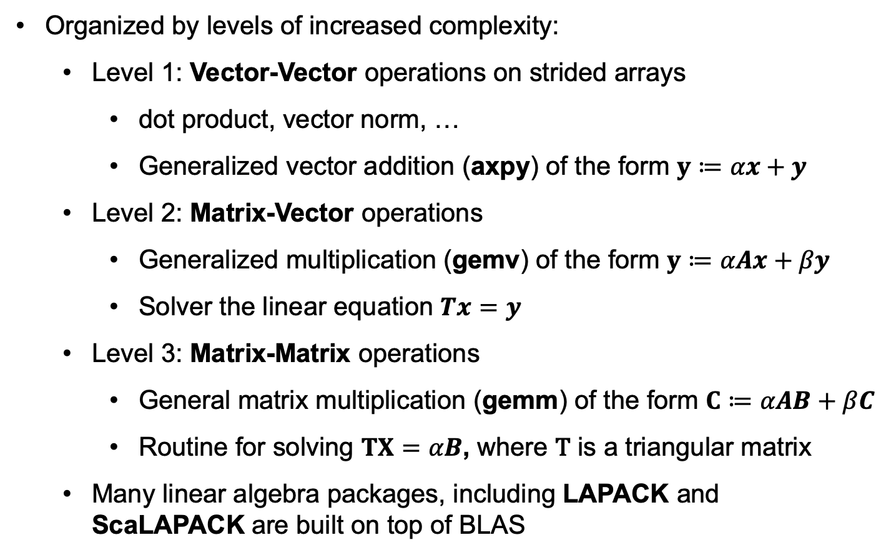
BLAS: Basic Linear Algebra Subprograms
Organized by levels of increased complexity:
Level 1: Vector-Vector operations on strided arrays
dot product, vector norm, …
Generalized vector addition (axpy) of the form $y≔αx+y$
Level 2: Matrix-Vector operations
Generalized multiplication (gemv) of the form $y≔αAx+βy$
Solver the linear equation $Tx=y$
Level 3: Matrix-Matrix operations
General matrix multiplication (gemm) of the form $C≔αAB+βC$
Routine for solving $TX=αB$, where T is a triangular matrix
Many linear algebra packages, including LAPACK and ScaLAPACK are built on top of BLAS

Slide 6
BLAS Naming Conventions I

Slide 7
BLAS Naming Conventions II

Slide 8
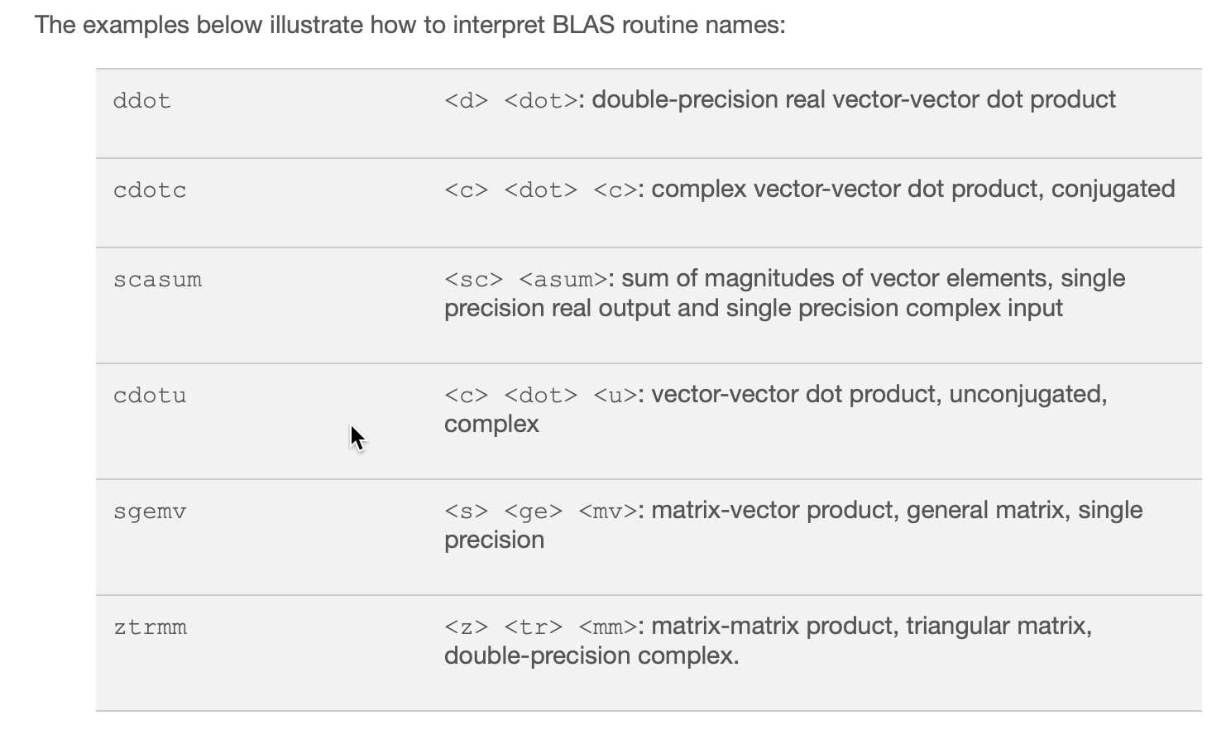
BLAS Naming Conventions III (examples)

Slide 9
BLAS Naming Conventions IV (concrete example)

Slide 10
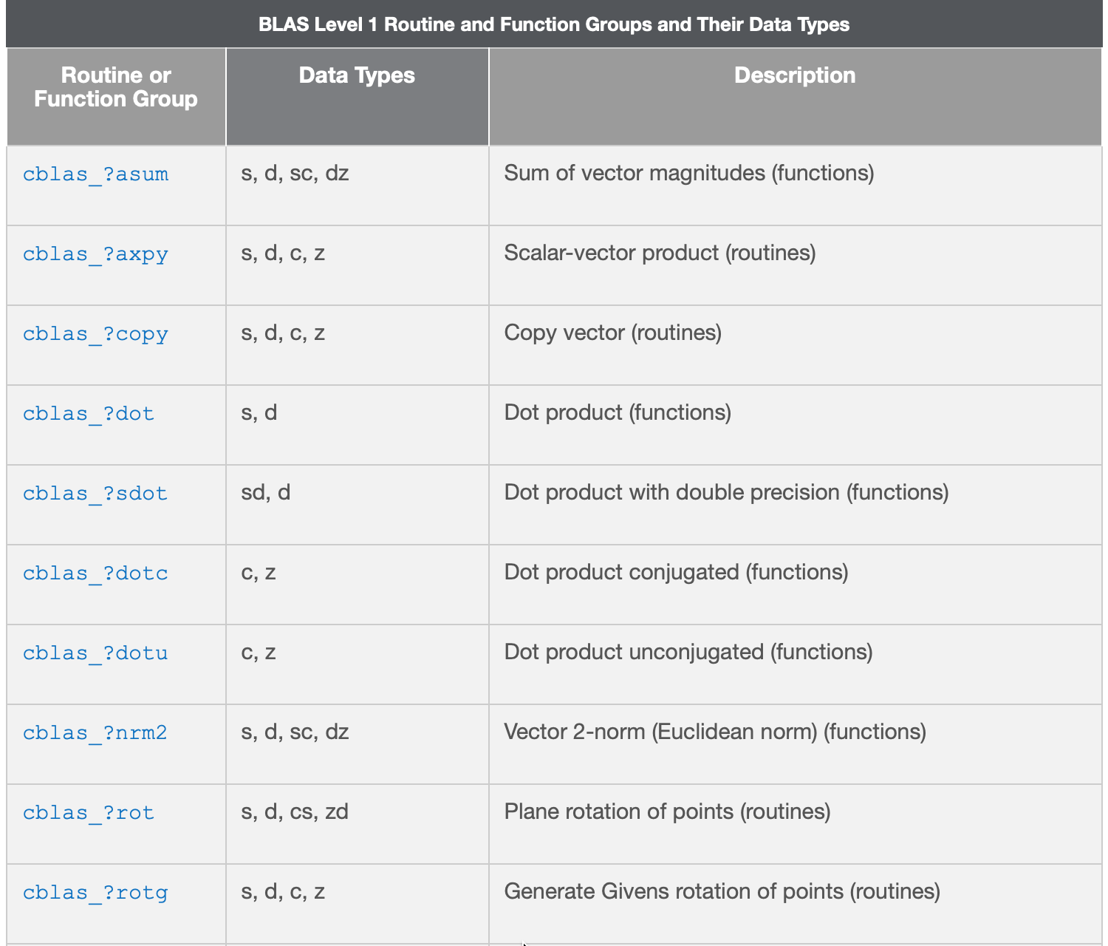
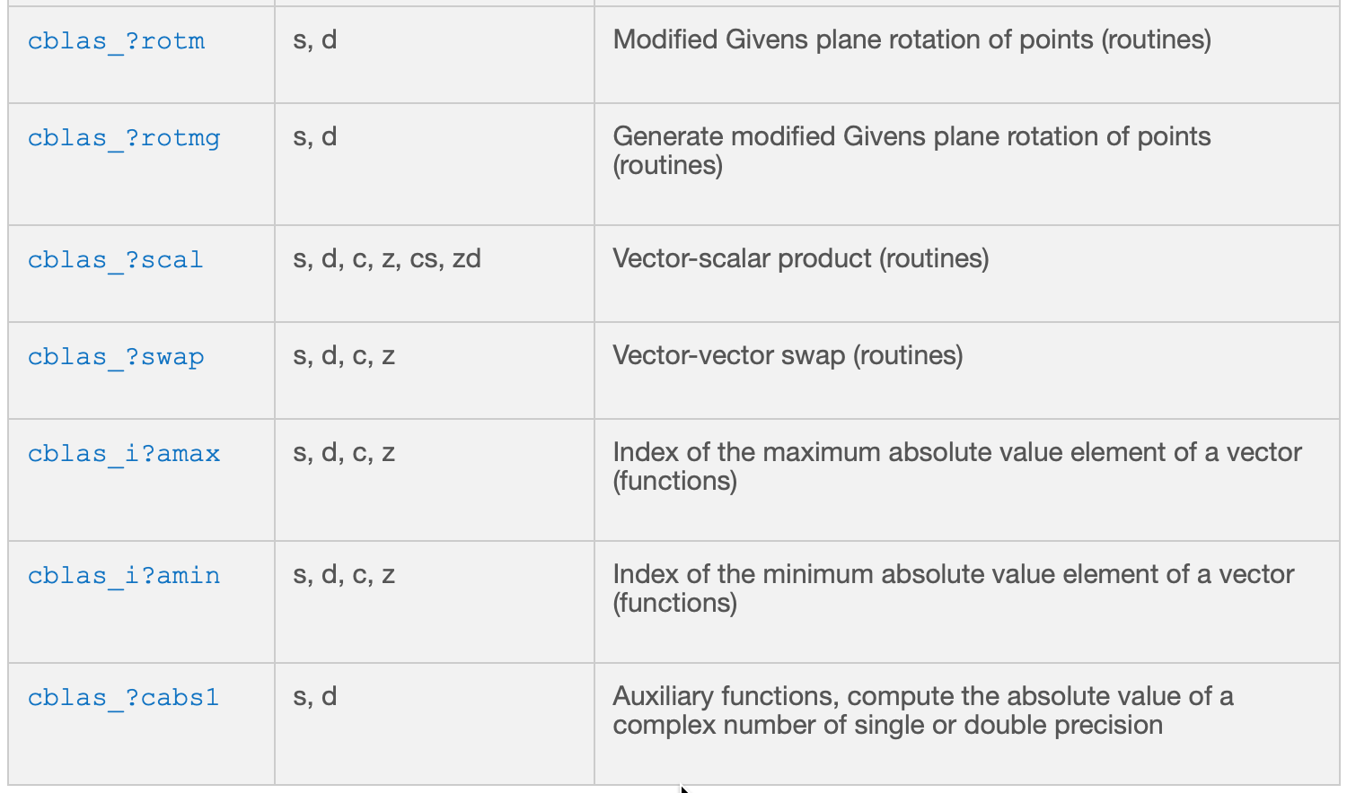
BLAS Level 1 Routines:

Slide 11
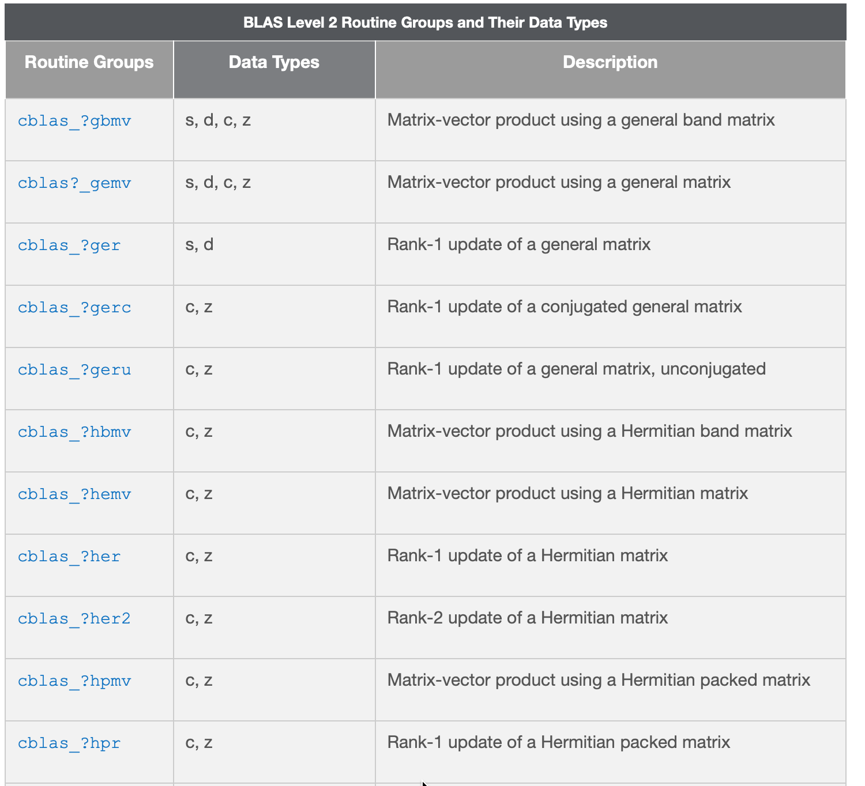
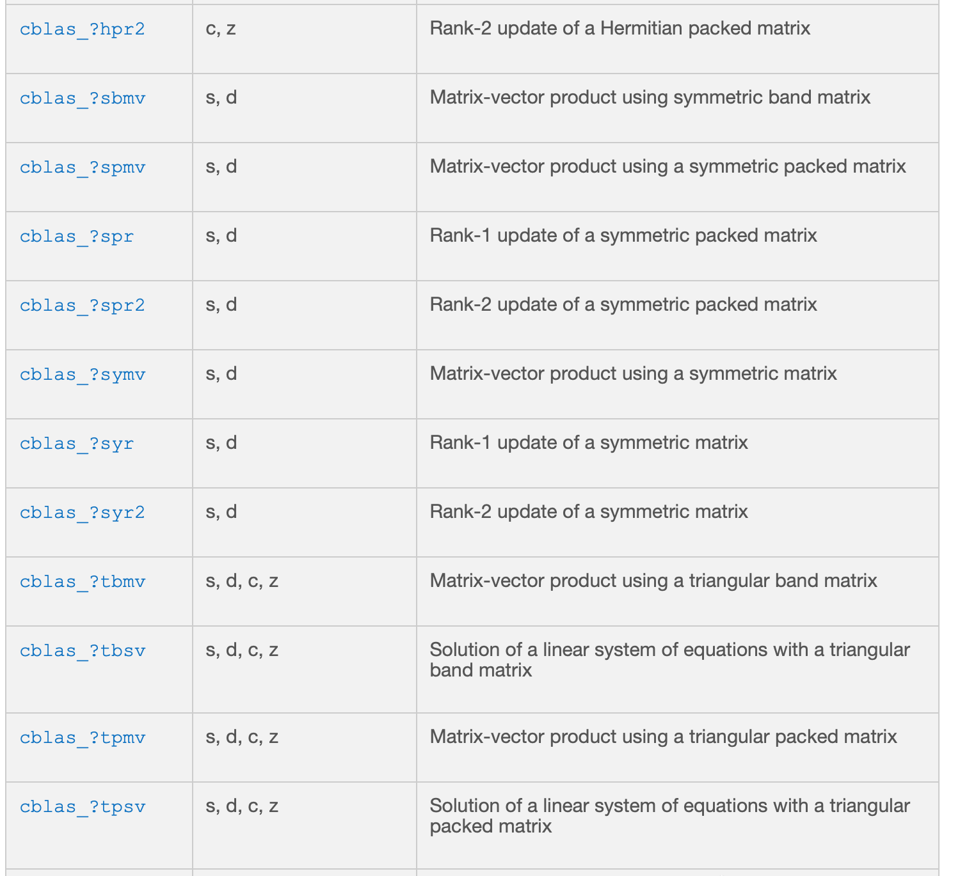
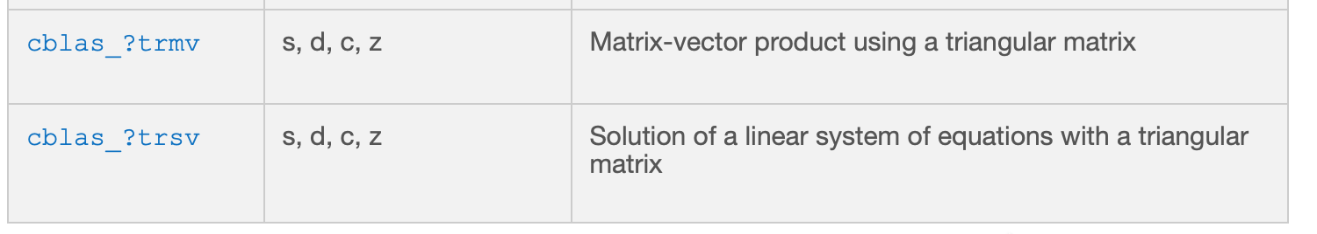
BLAS Level 2 Routines:

Slide 12
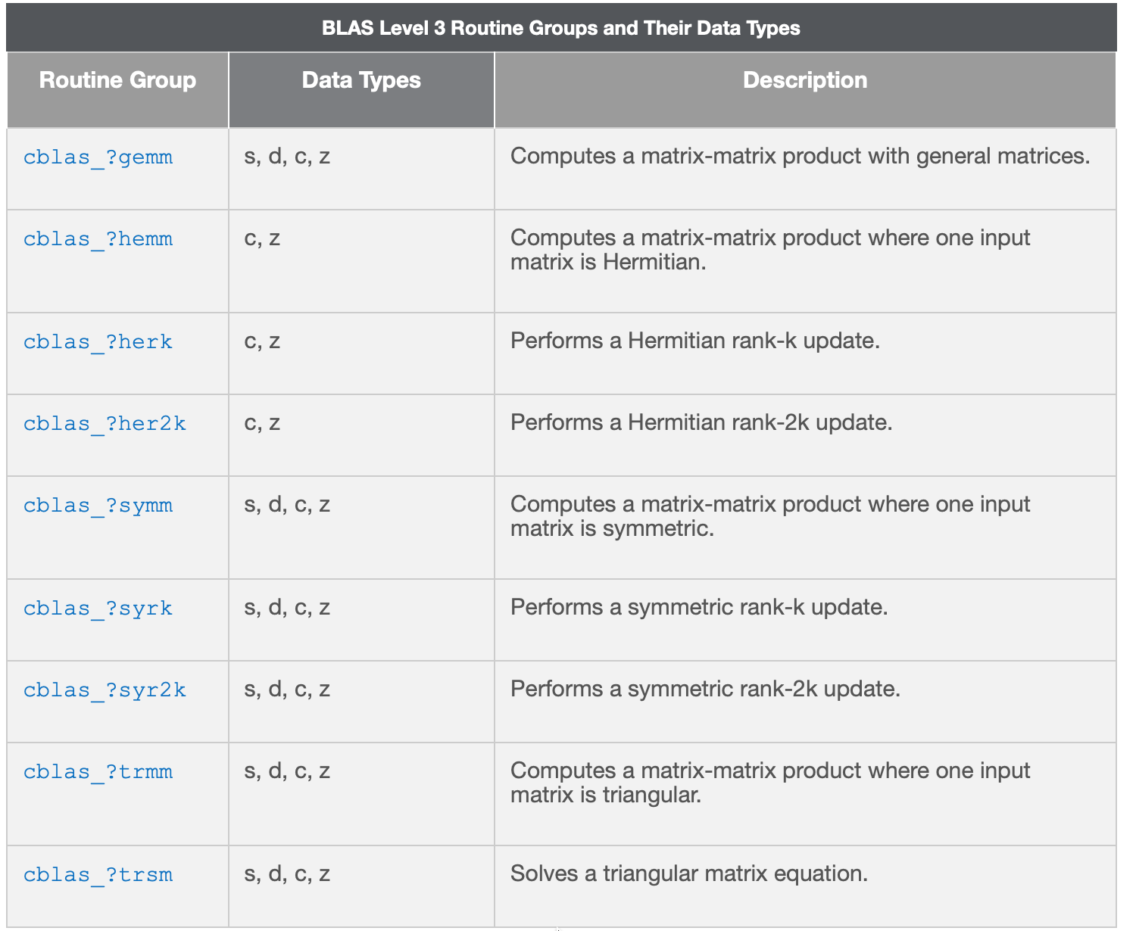
BLAS Level 3 Routines:

Slide 13
Example: BLAS

Slide 14
LAPACK: Linear Algebra Package
Solves dense or special case sparse systems of equations depending on matrix properties such as:
Precision: single, double
Data type: real, complex
Shape: diagonal, bidiagonal, tridiagonal, banded, triangular, trapezoidal, Hessenberg, general dense
Properties: orthogonal, positive definite, Hermitian (complex), symmetric, general
Provides routines for:
Solving systems of linear equations and linear least squares
Solving eigenvalue problems and singular value decomposition
Matrix factorizations: LU, QR, Cholesky, and Schur decomposition

Slide 15
LAPACK Naming Conventions I
A LAPACK subroutine name is in the form pmmaaa, where:
p: 1-letter code denoting the type of numerical constants used
s: real single precision
d: real double precision
c: complex single precision
z: complex double precision
mm: 2-letter code denoting the kind of matrix expected by the algorithm
Each kind of matrix has its own data structure format
aaa: 1-3 letter code describing the algorithm implemented in the subroutine

Slide 16
LAPACK Naming Conventions II: Matrix Types
Name | Description
BD | bidiagonal
DI | diagonal
GB | general band
GE | general (i.e., unsymmetric, in some cases rectangular)
GG | general matrices, generalized problem (i.e., a pair of general matrices)
GT | general tridiagonal
HB | (complex) Hermitian band
HE | (complex) Hermitian
HG | upper Hessenberg matrix, generalized problem (i.e a Hessenberg and a triangular matrix)
HP | (complex) Hermitian, packed storage
HS | upper Hessenberg
OP | (real) orthogonal, packed storage
OR | (real) orthogonal
PB | symmetric or Hermitian positive definite band
Name | Description
PO | symmetric or Hermitian positive definite
PP | symmetric or Hermitian positive definite, packed storage
PT | symmetric or Hermitian positive definite tridiagonal
SB | (real) symmetric band
SP | symmetric, packed storage
ST | (real) symmetric tridiagonal
SY | symmetric
TB | triangular band
TG | triangular matrices, generalized problem (i.e., a pair of triangular matrices)
TP | triangular, packed storage
TR | triangular (or in some cases quasi-triangular)
TZ | trapezoidal
UN | (complex) unitary
UP | (complex) unitary, packed storage

Slide 17
LAPACK: Matrices & Performance I
Cache-based architectures:
Perform floating-point operations (flops) at very fast rates
Fetch data from memory at a much slower rate
Matrix-matrix multiplication (gemm) the memory bandwidth bottleneck can be overcome by moving submatrices into the processor cache(s) and amortizing the overhead over a large number of flops
Given a high-performance implementation of gemm, other operations can attain high performance if the bulk of the computation can be cast in terms of gemm
This is property of blocked algorithms
For this reason LAPACK considers different matrix types and representations

Slide 18
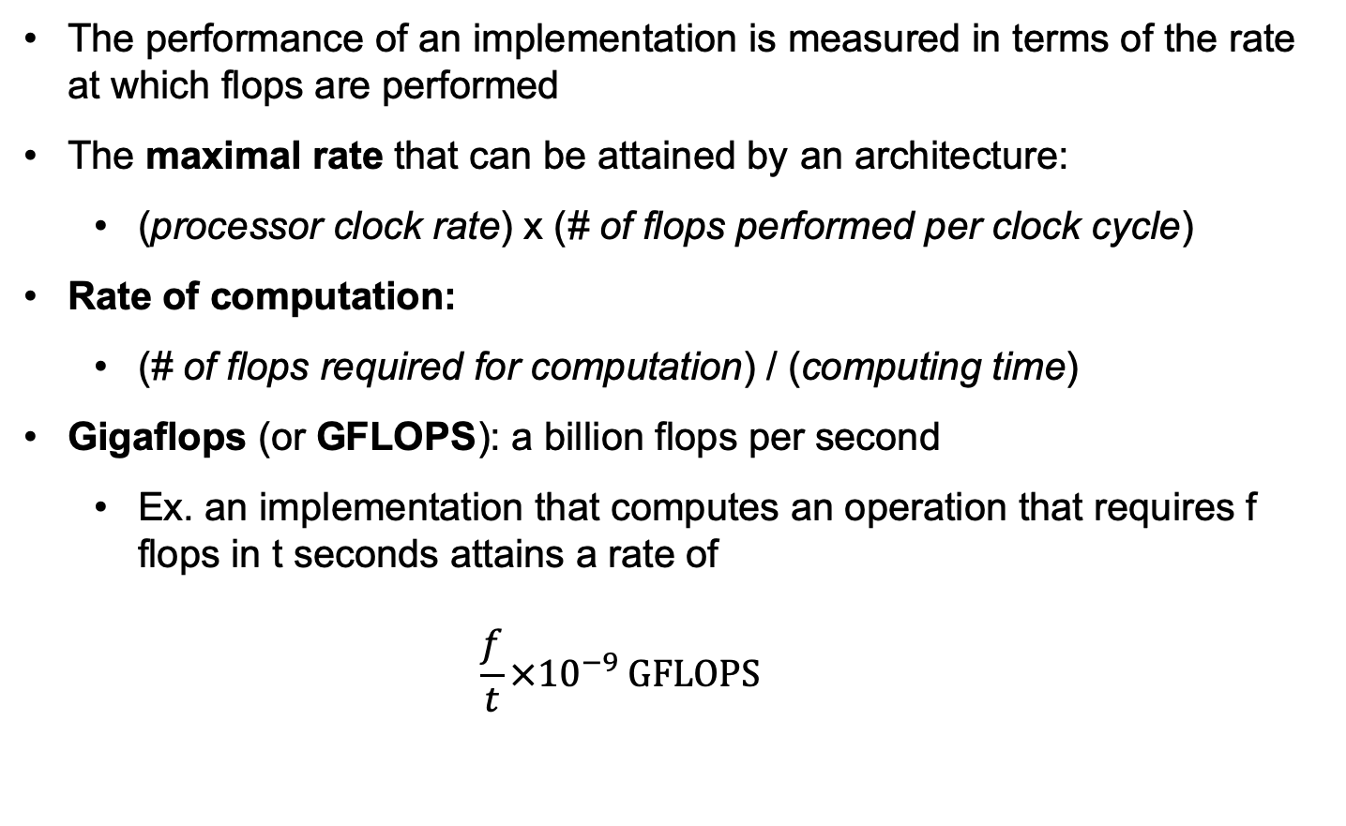
LAPACK: Matrices & Performance II
The performance of an implementation is measured in terms of the rate at which flops are performed
The maximal rate that can be attained by an architecture:
(processor clock rate) x (# of flops performed per clock cycle)
Rate of computation:
(# of flops required for computation) / (computing time)
Gigaflops (or GFLOPS): a billion flops per second
Ex. an implementation that computes an operation that requires f flops in t seconds attains a rate of $\frac{f}{t}×{10}^{−9} GFLOPS$

Slide 19
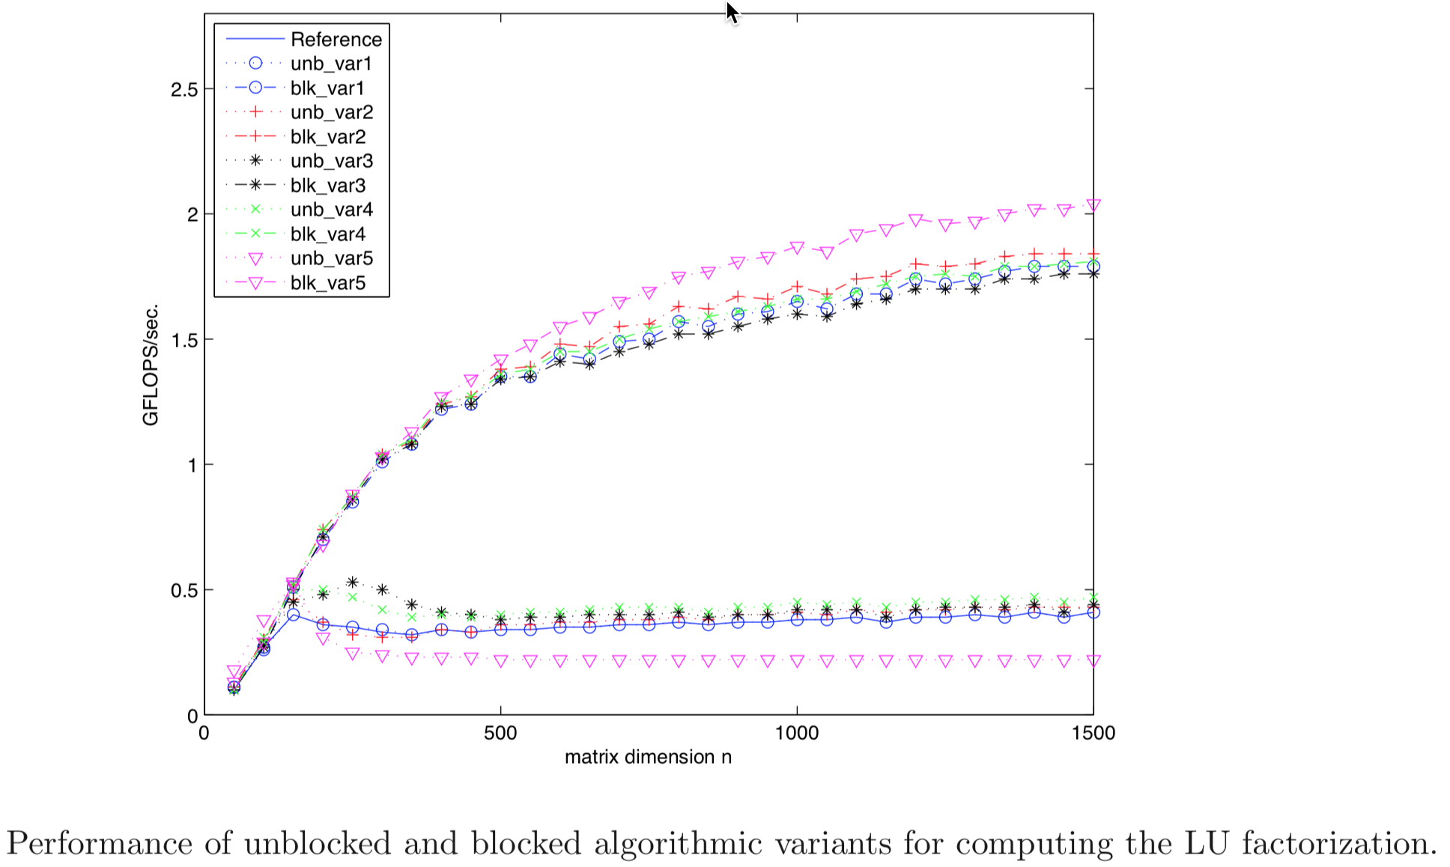
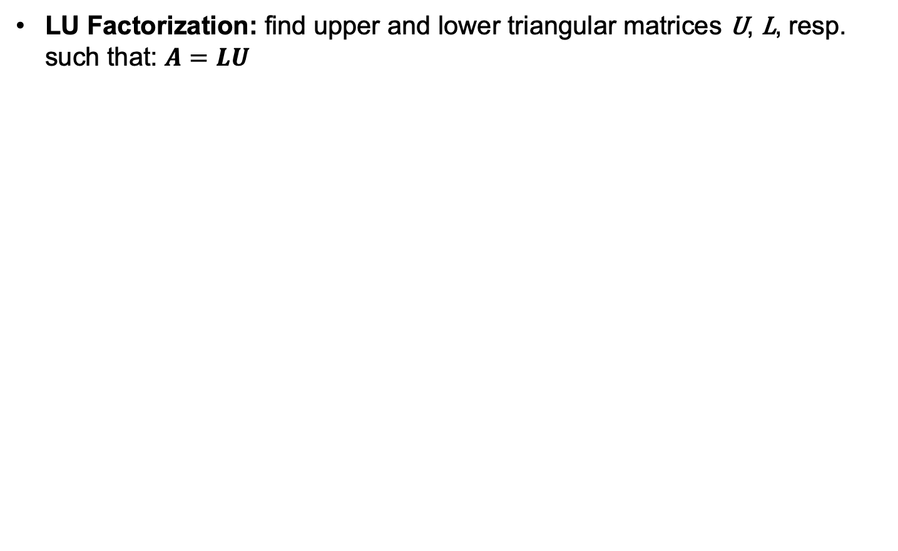
LAPACK: Matrices & Performance III
LU Factorization: find upper and lower triangular matrices U, L, resp. such that: $A=LU$

Slide 20
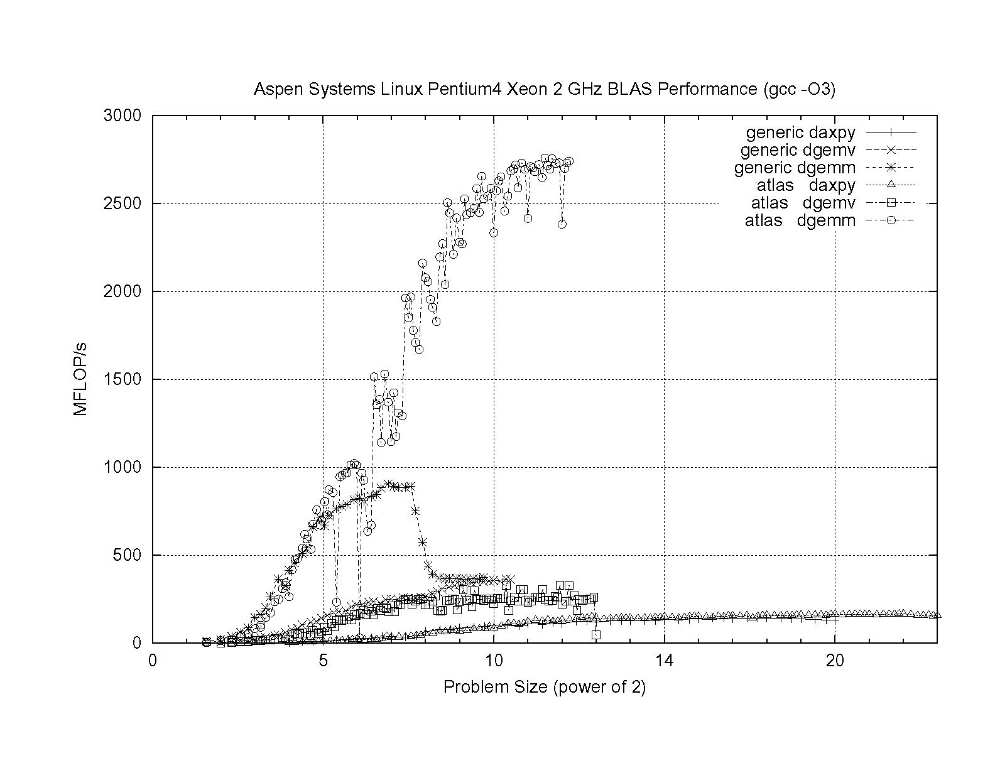
LAPACK: Matrices & Performance IV
ATLAS vs. BLAS: Performance obtained in ATLAS by tuning block sizes to system cache(s)
DGEMM: Double precision GEneral Matrix-Matrix multiply
DGEMV: Double precision GEneral Matrix-Vector multiply

Slide 21
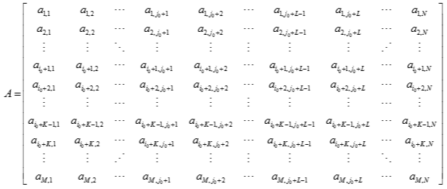
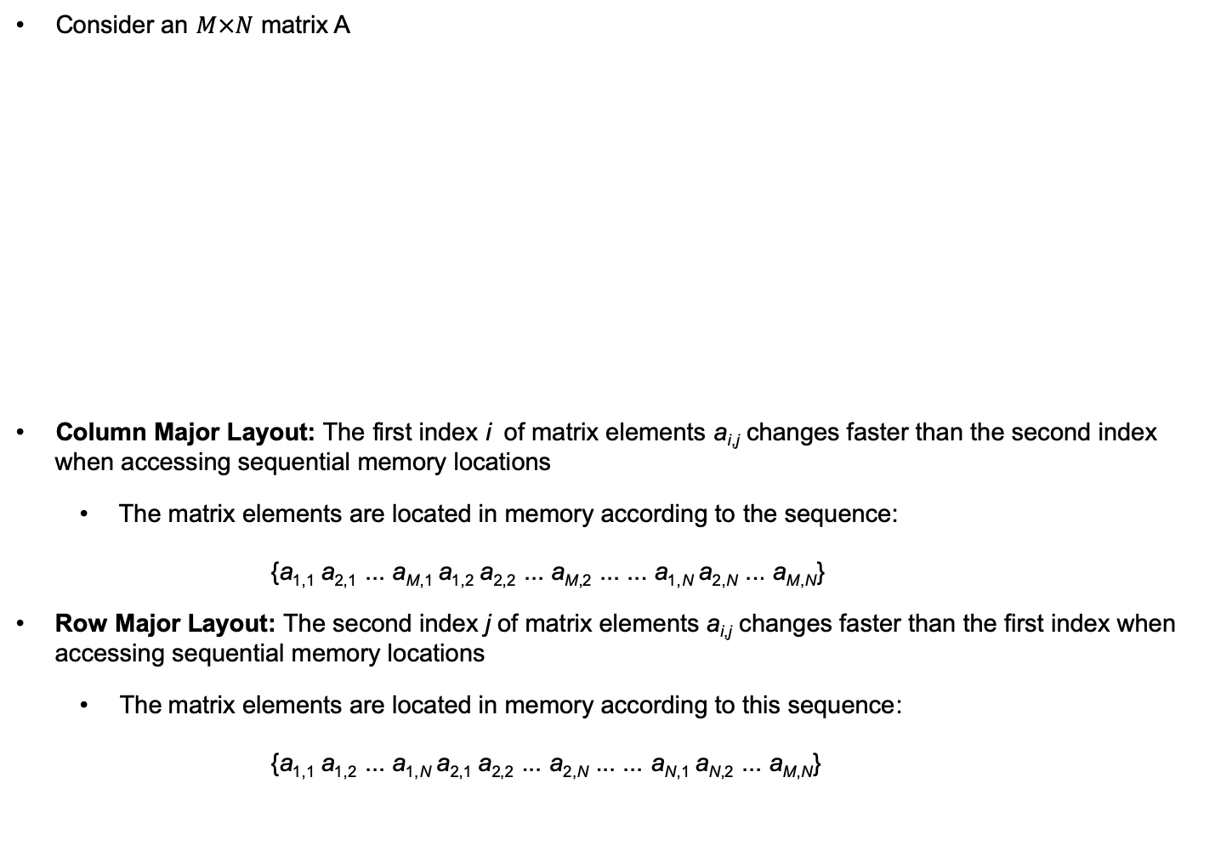
LAPACK: Matrix Storage Layout
Consider an $M×N$ matrix A
Column Major Layout: The first index i of matrix elements a_{i,j} changes faster than the second index when accessing sequential memory locations
The matrix elements are located in memory according to the sequence: {a_{1,1} a_{2,1} ... a_{M,1} a_{1,2} a_{2,2} ... a_{M,2} ... ... a_{1,N} a_{2,N} ... a_{M,N}}
Row Major Layout: The second index j of matrix elements a_{i,j} changes faster than the first index when accessing sequential memory locations
The matrix elements are located in memory according to this sequence: {a_{1,1} a_{1,2} ... a_{1,N} a_{2,1} a_{2,2} ... a_{2,N} ... ... a_{N,1} a_{N,2} ... a_{M,N}}

Slide 22
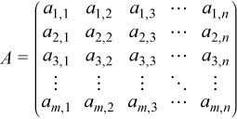
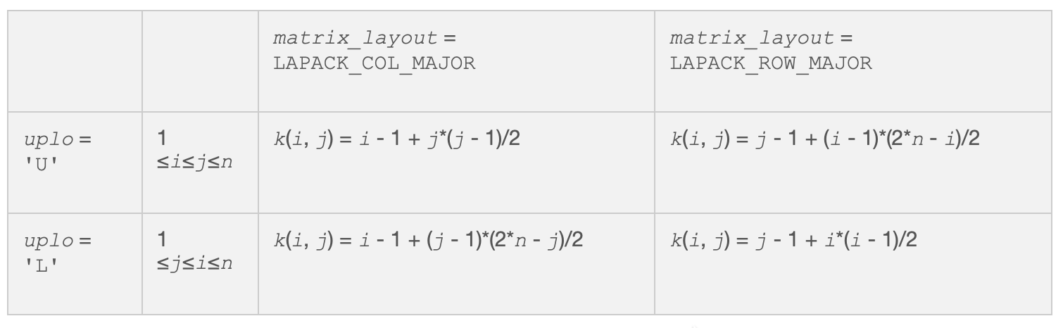
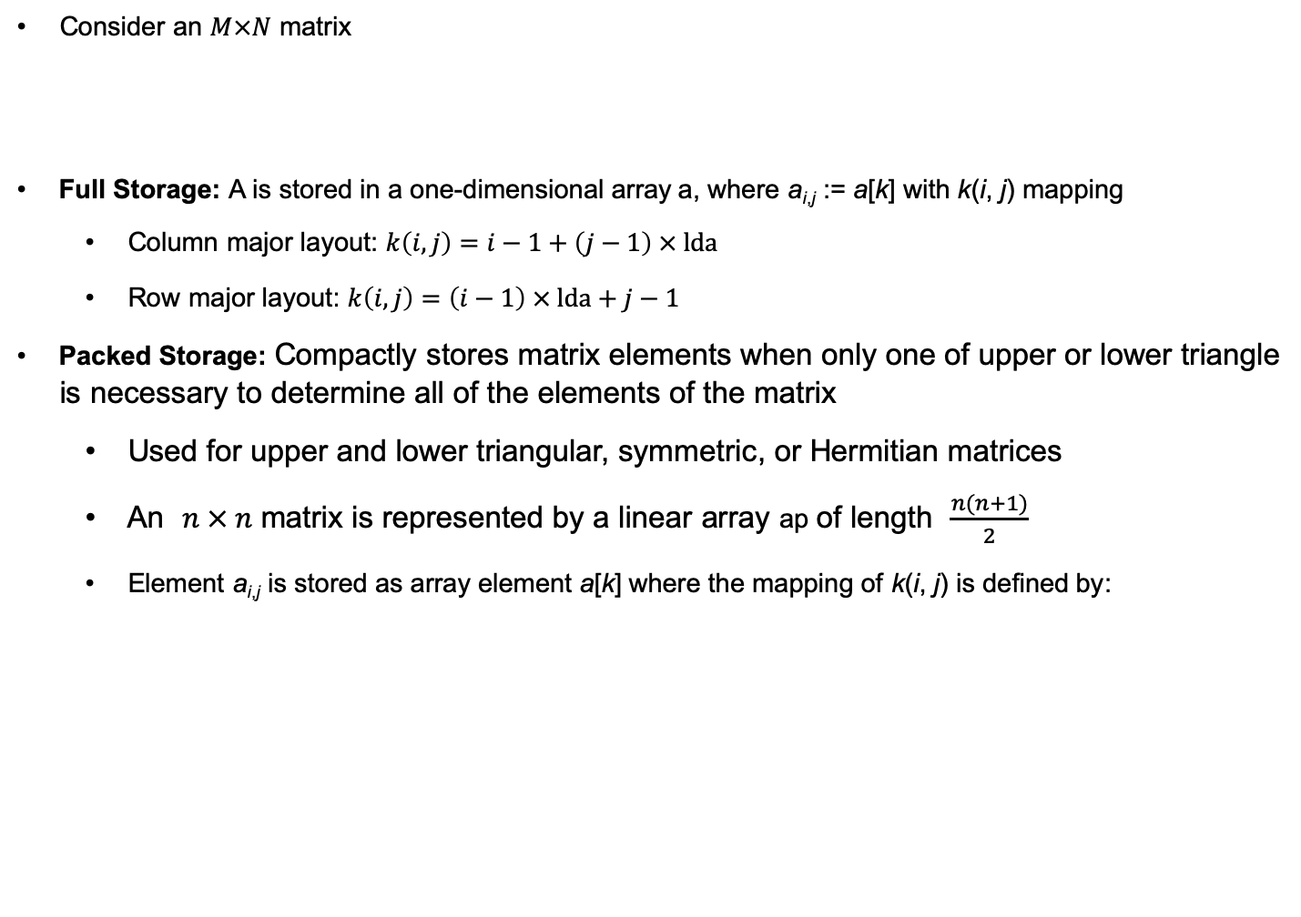
LAPACK: Matrix Storage Schemes I
Consider an $M×N$ matrix
Full Storage: A is stored in a one-dimensional array a, where a_{i,j} := a[k] with k(i, j) mapping
Column major layout: $k\left(i,j\right)=i−1+\left(j−1\right) × \text{lda}$
Row major layout: $k\left(i,j\right)=\left(i−1\right) × \text{lda}+j−1$
Packed Storage: Compactly stores matrix elements when only one of upper or lower triangle is necessary to determine all of the elements of the matrix
Used for upper and lower triangular, symmetric, or Hermitian matrices
An $n × n$ matrix is represented by a linear array ap of length $\frac{n(n+1)}{2}$
Element a_{i,j} is stored as array element a[k] where the mapping of k(i, j) is defined by:

Slide 23
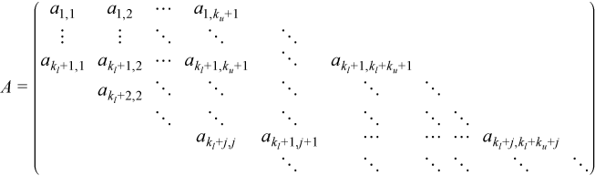
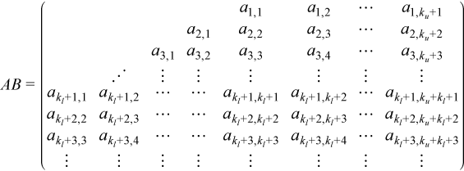
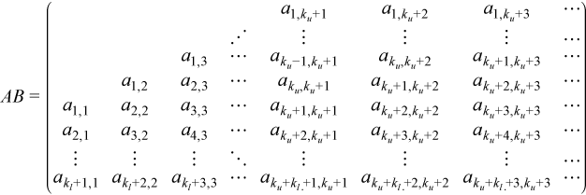
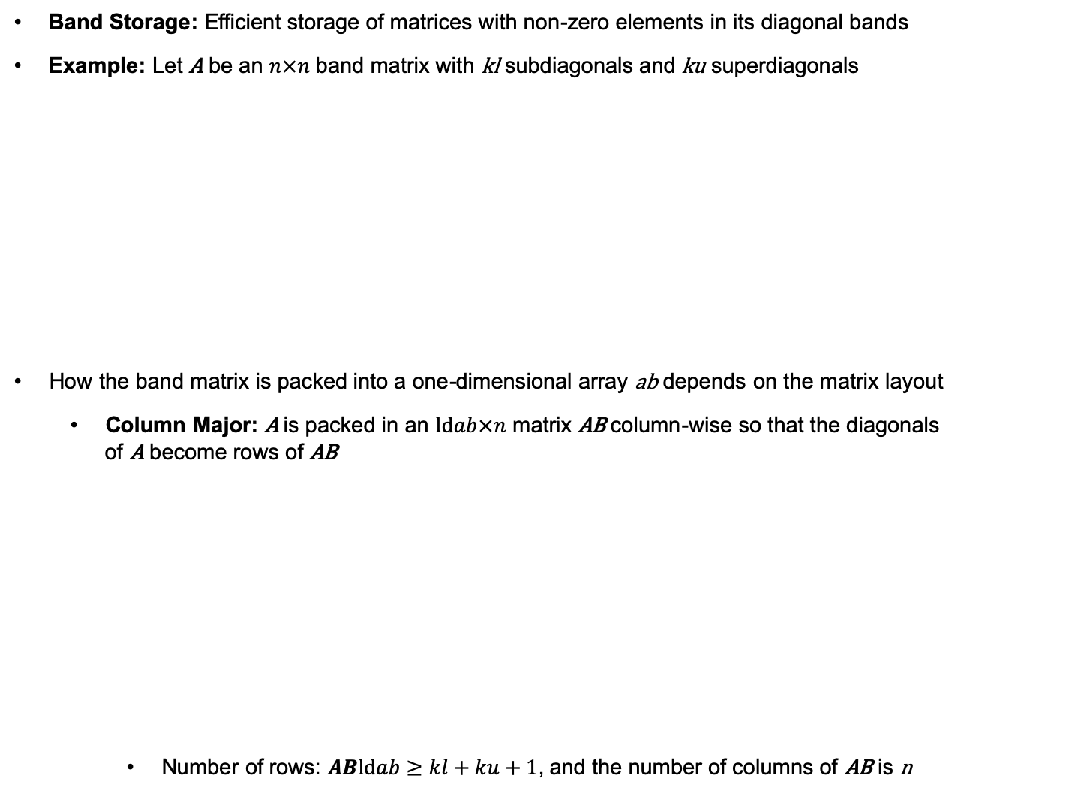
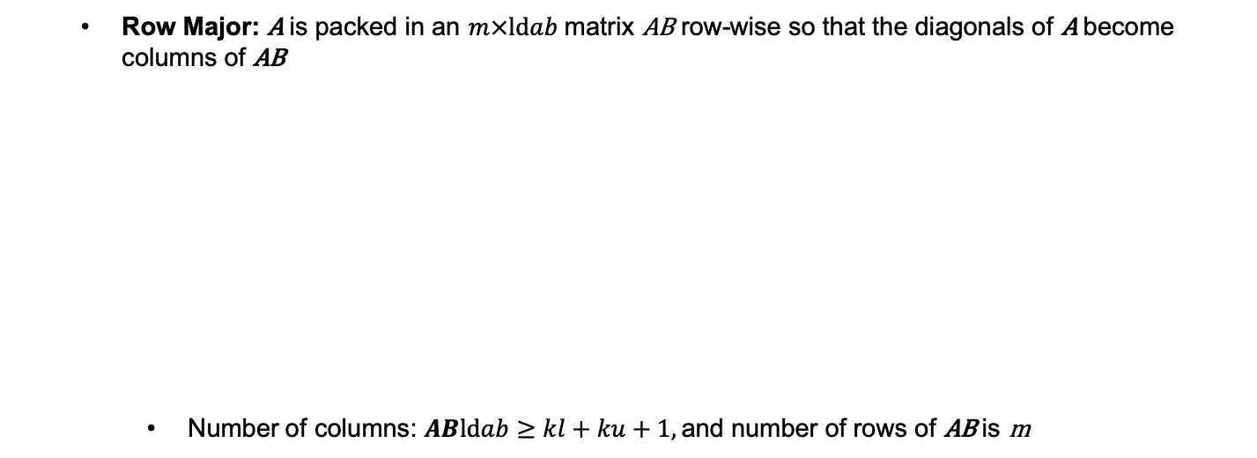
LAPACK: Matrix Storage Schemes II
Band Storage: Efficient storage of matrices with non-zero elements in its diagonal bands
Example: Let A be an $n×n$ band matrix with kl subdiagonals and ku superdiagonals
How the band matrix is packed into a one-dimensional array ab depends on the matrix layout
Column Major: A is packed in an $\text{ld}ab×n$ matrix AB column-wise so that the diagonals of A become rows of AB
Number of rows: $AB\text{ld}ab≥kl+ku+1$, and the number of columns of AB is n
Row Major: A is packed in an $m×\text{ld}ab$ matrix AB row-wise so that the diagonals of A become columns of AB
Number of columns: $AB\text{ld}ab≥kl+ku+1$, and number of rows of AB is m

Slide 24
LAPACK: Matrix Storage Schemes III
Rectangular Full Packed Storage:
Combination of full and packed storage
Store the upper or lower triangle of a matrix which is upper triangular, lower triangular, symmetric, or Hermitian
Offers the storage savings of packed storage plus the efficiency of using full storage Level 3 BLAS and LAPACK routines
Three parameters define the storage scheme:
matrix_layout: Specifies column major or row major matrix layout
uplo: Specifies that the upper triangle (with value 'U') or the lower triangle (with value 'L') is stored
transr: Specifies normal (with value 'N'), transpose (with the 'T'), or conjugate transpose (with the 'C') operation on the matrix
Example: Consider A upper triangular - uplo = U
Not transposed
transr = N
Transposed
transr = T

Slide 25
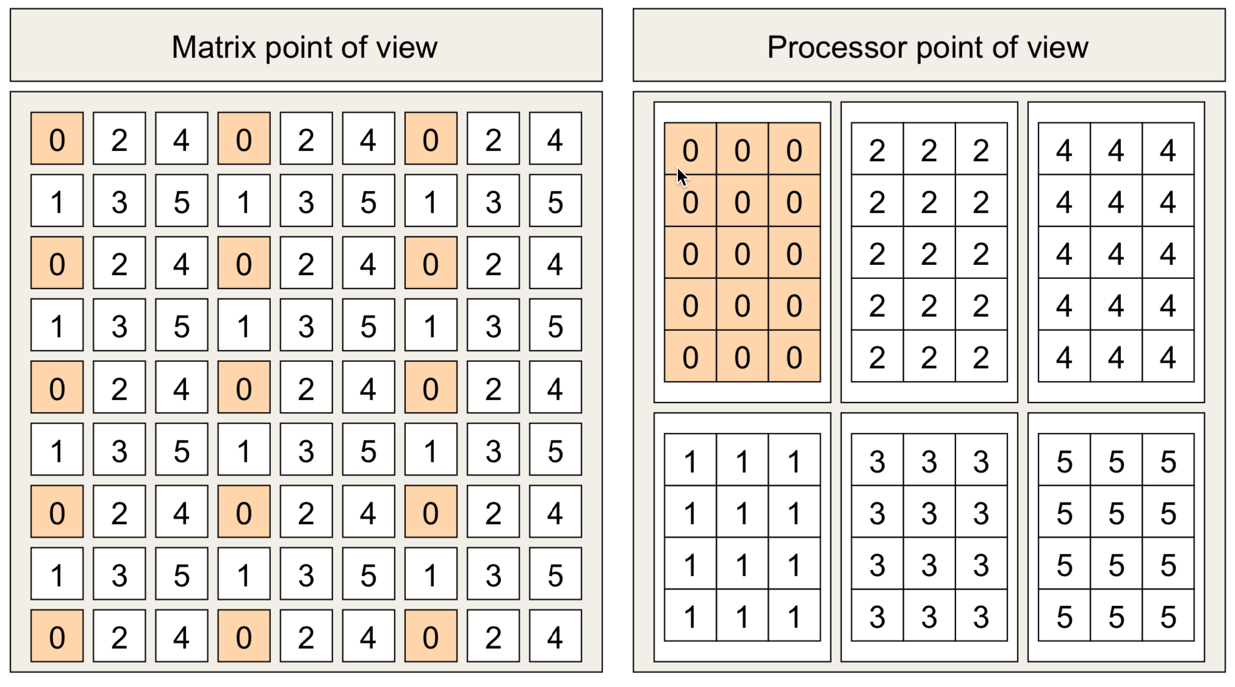
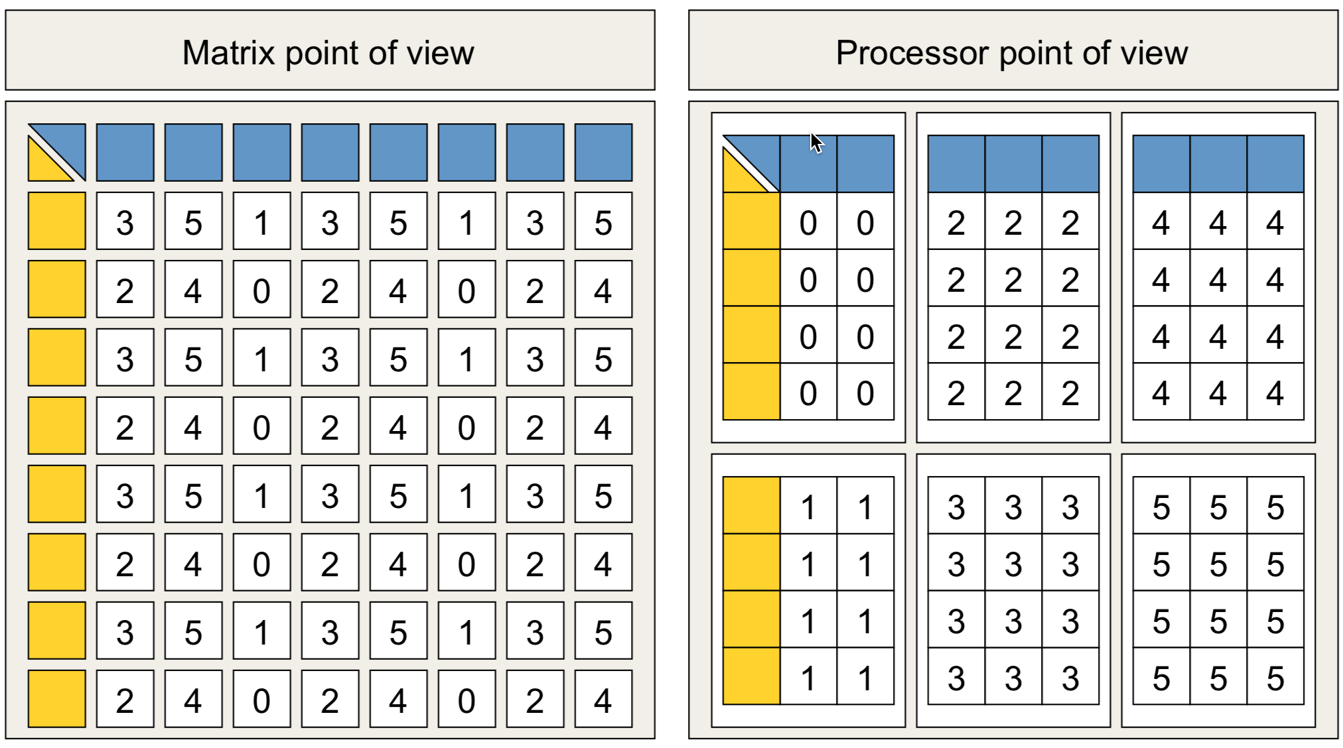
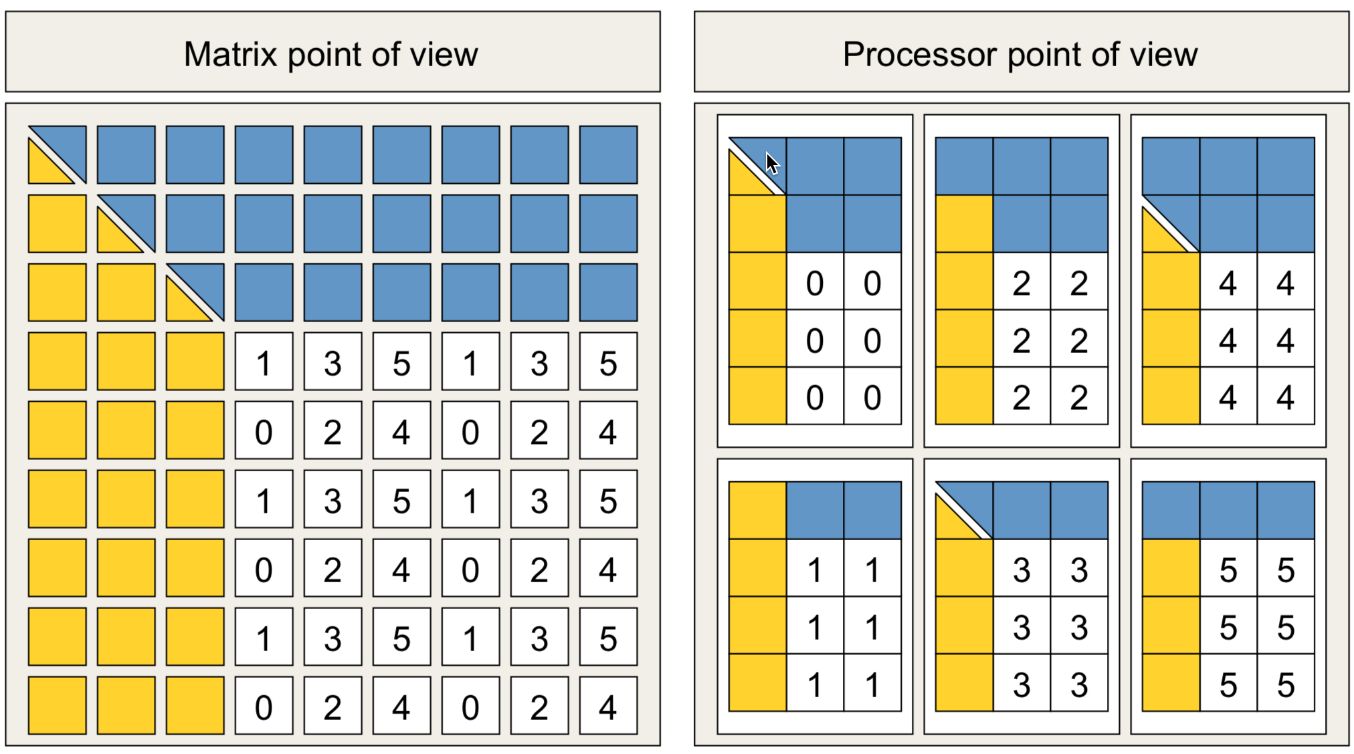
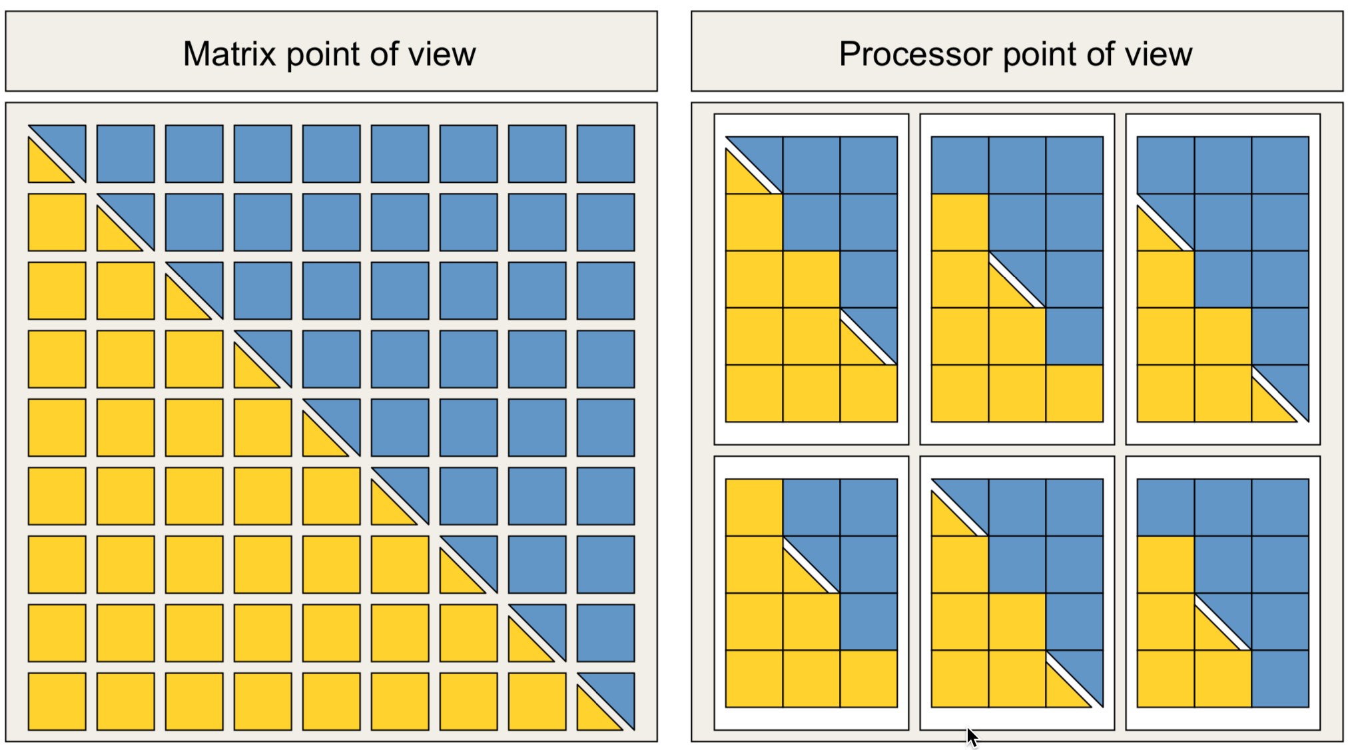
LAPACK: Matrix Storage Schemes IV
LAPACK utilizes matrix subdivision, storage packing to more efficiently utilize processor features (vector operations, cache operations, …)

Slide 26
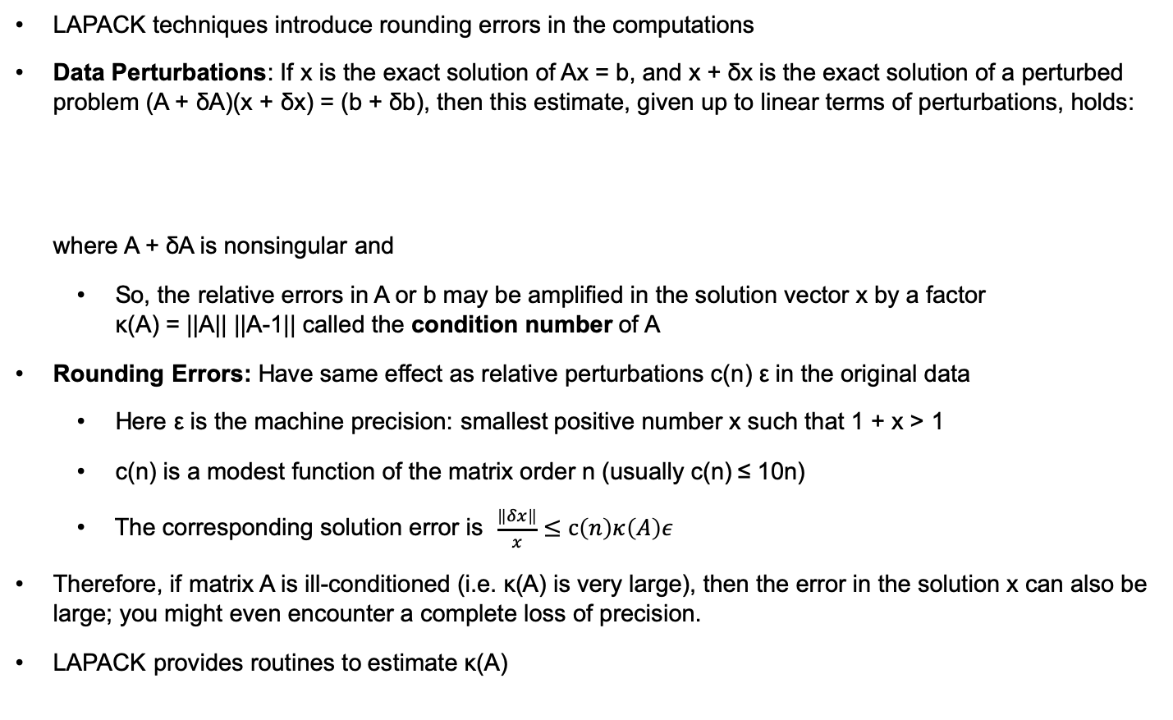
LAPACK: Error Analysis
LAPACK techniques introduce rounding errors in the computations
Data Perturbations: If x is the exact solution of Ax = b, and x + δx is the exact solution of a perturbed problem (A + δA)(x + δx) = (b + δb), then this estimate, given up to linear terms of perturbations, holds: where A + δA is nonsingular and
So, the relative errors in A or b may be amplified in the solution vector x by a factor κ(A) = ||A|| ||A-1|| called the condition number of A
Rounding Errors: Have same effect as relative perturbations c(n) ε in the original data
Here ε is the machine precision: smallest positive number x such that 1 + x > 1
c(n) is a modest function of the matrix order n (usually c(n) ≤ 10n)
The corresponding solution error is $\frac{\left\|δx\right\|}{x}≤\text{c}\left(n\right)κ\left(A\right)ε$
Therefore, if matrix A is ill-conditioned (i.e. κ(A) is very large), then the error in the solution x can also be large; you might even encounter a complete loss of precision.
LAPACK provides routines to estimate κ(A)

Slide 27
LAPACK Routines I
Intel MKL implements routines from the LAPACK package that are used for solving real and complex:
Systems of linear equations,
Linear least squares problems
Eigenvalue and singular value problems,
Also performing a number of related computational tasks like factorization and inversion of matrices
Routines are supported for systems of equations with the following types of matrices:
General
Banded
Symmetric or Hermitian positive-definite (full, packed, and rectangular full packed (RFP) storage)
Symmetric or Hermitian positive-definite banded
Symmetric or Hermitian indefinite (both full and packed storage)
Symmetric or Hermitian indefinite banded
Triangular (full, packed, and RFP storage)
Triangular banded
Tridiagonal

Slide 28
LAPACK Routines II
LAPACK Linear Equation Routines for performing the following computations:
Factoring the matrix (except for triangular matrices)
Equilibrating the matrix (except for RFP matrices)
Solving a system of linear equations
Estimating the condition number of a matrix (except for RFP matrices)
Refining the solution of linear equations and computing its error bounds (except for RFP matrices)
Inverting the matrix.
LAPACK Least Squares and Eigenvalue Problem Computational Routines for:
Orthogonal Factorizations
Singular Value Decomposition
Symmetric Eigenvalue Problems
Generalized Symmetric-Definite Eigenvalue Problems
Nonsymmetric Eigenvalue Problems
Generalized Nonsymmetric Eigenvalue Problems
Generalized Singular Value Decomposition

Slide 29
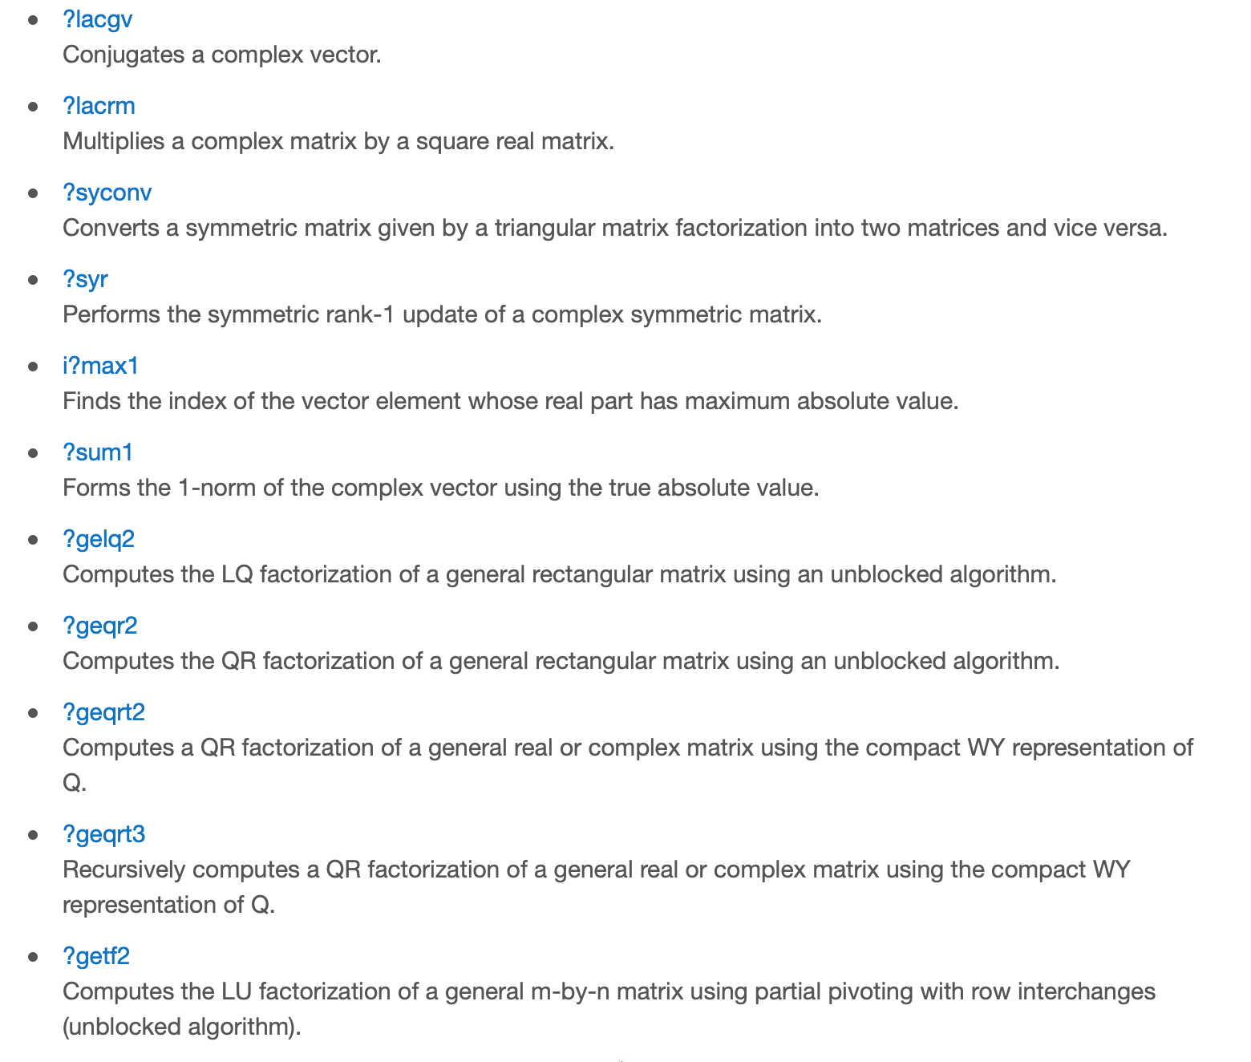
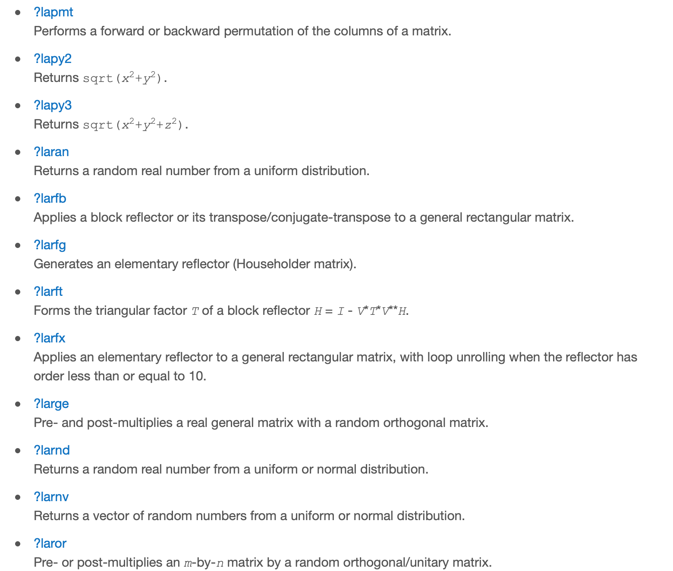
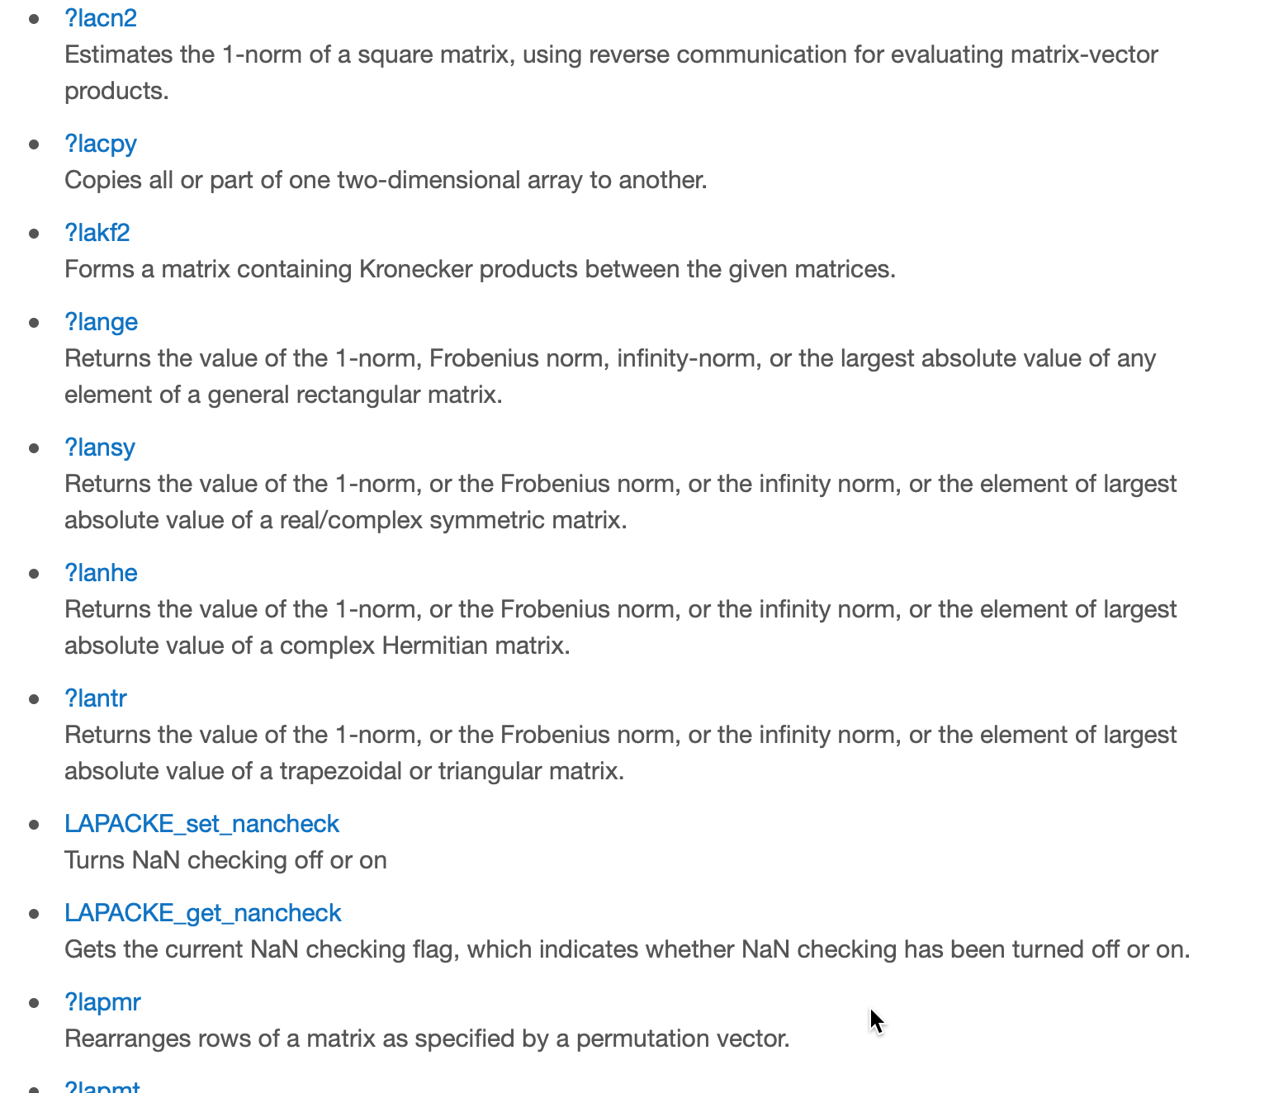
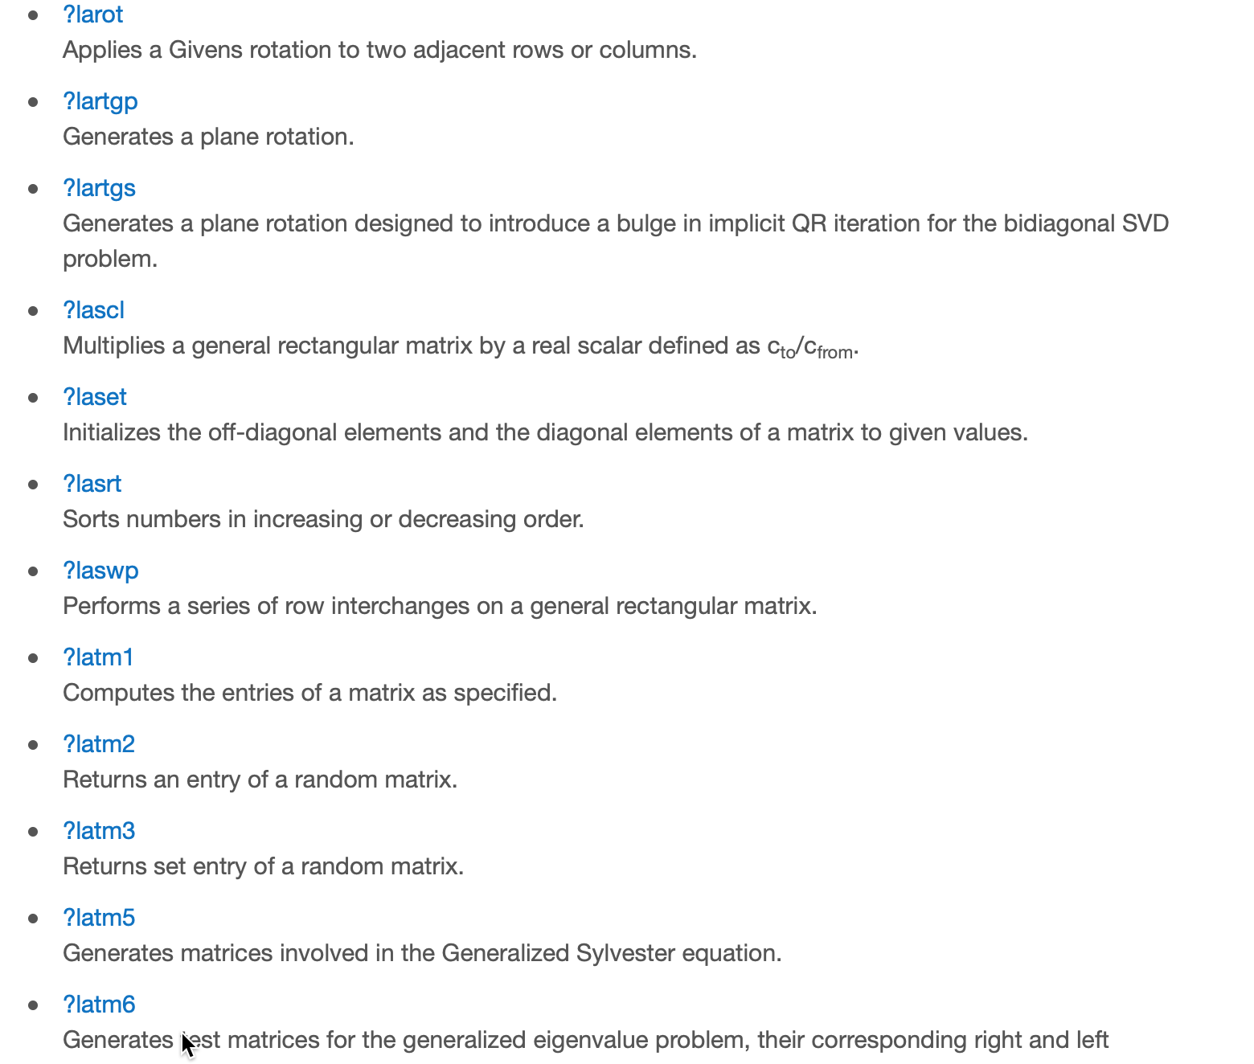
LAPACK Auxiliary Routines I

Slide 30
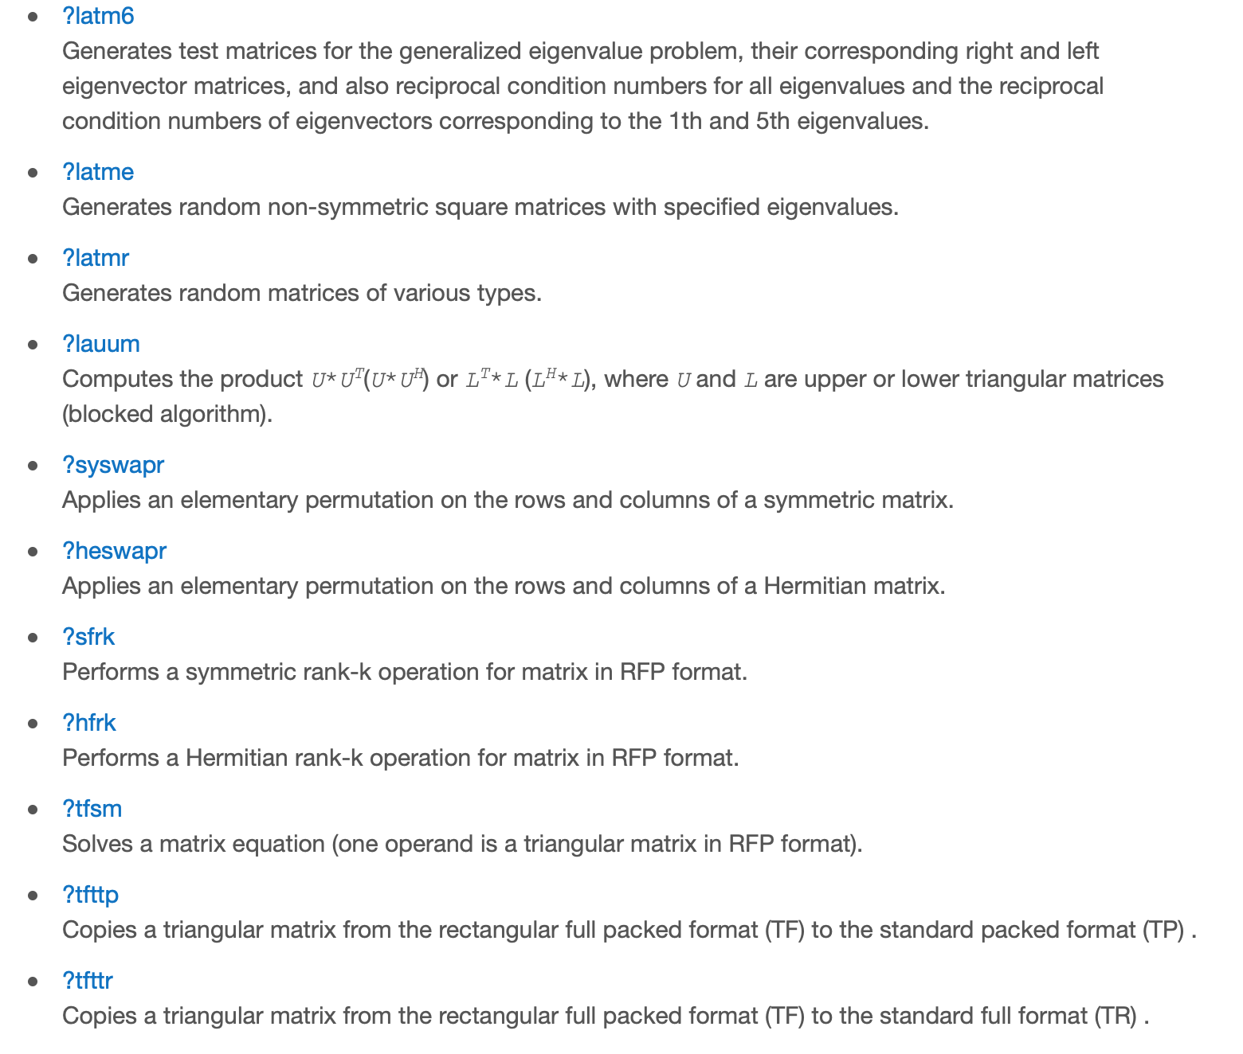
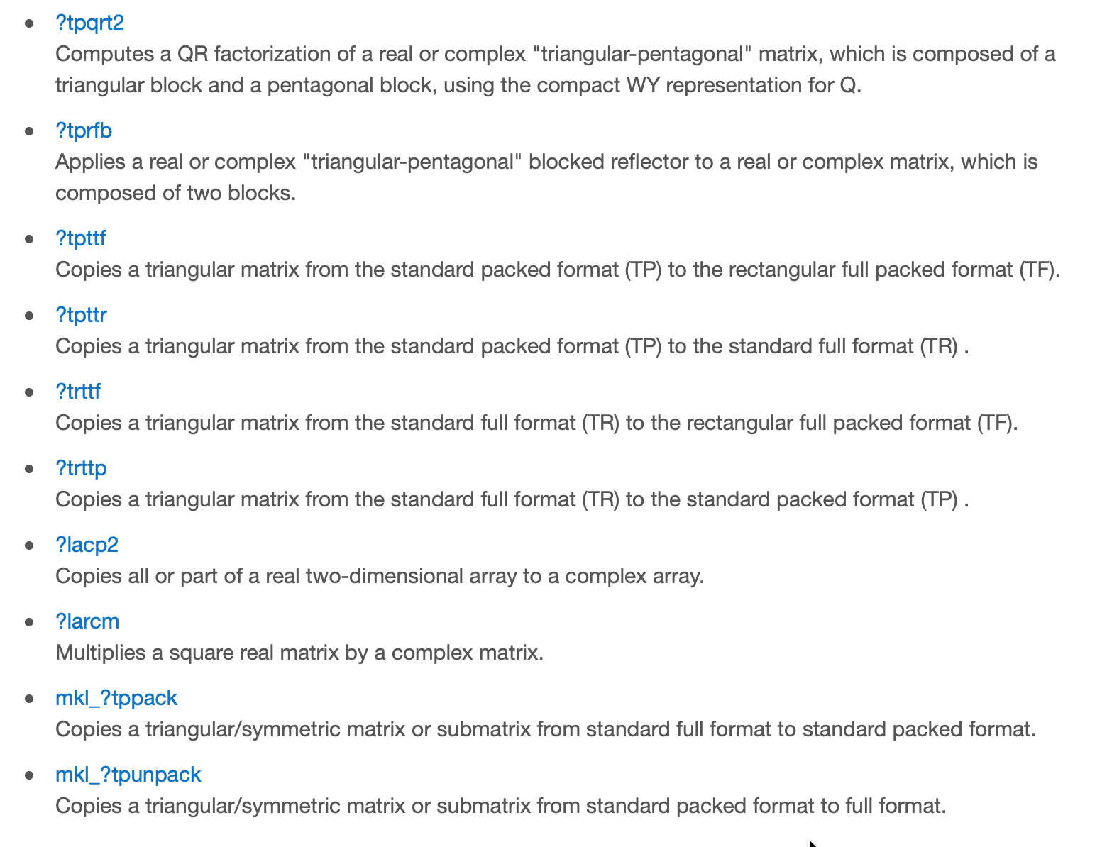
LAPACK Auxiliary Routines II

Slide 31
LAPACK naming concrete example: ?getrf

Slide 32
Example: LAPACK

Slide 33
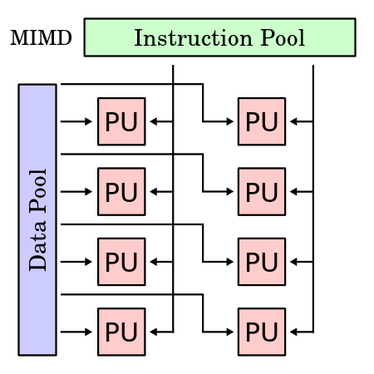
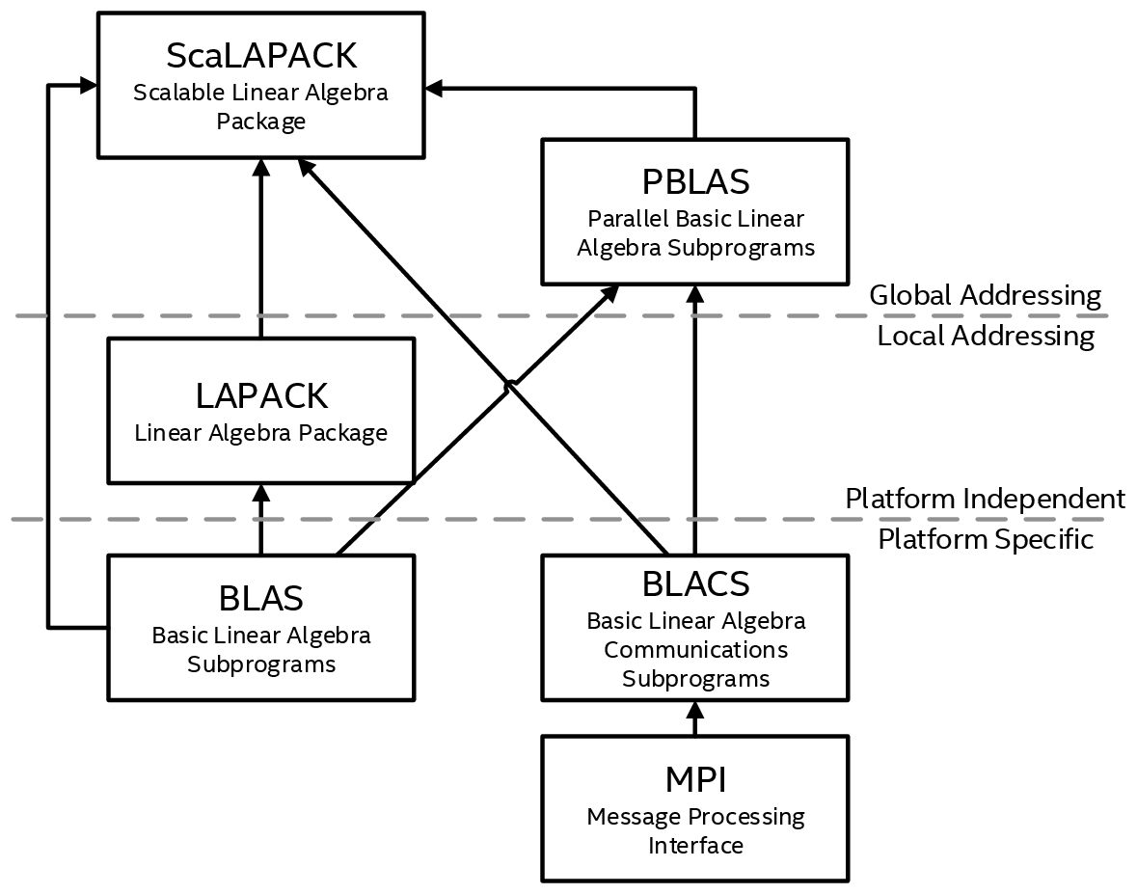
ScaLAPACK: Scalable LAPACK
Subset of LAPACK routines redesigned for distributed memory MIMD (multiple instruction, multiple data) parallel computers
Supports real and complex dense and band matrices
Solves:
Systems of linear equations
Linear least-squares problems
Eigenvalue and singular value problems
Related computational tasks
Runs on a network of computers using MPI as a message-passing layer and a set of prebuilt communication subprograms (BLACS), as well as a set of BLAS optimized for the target architecture.

Slide 34
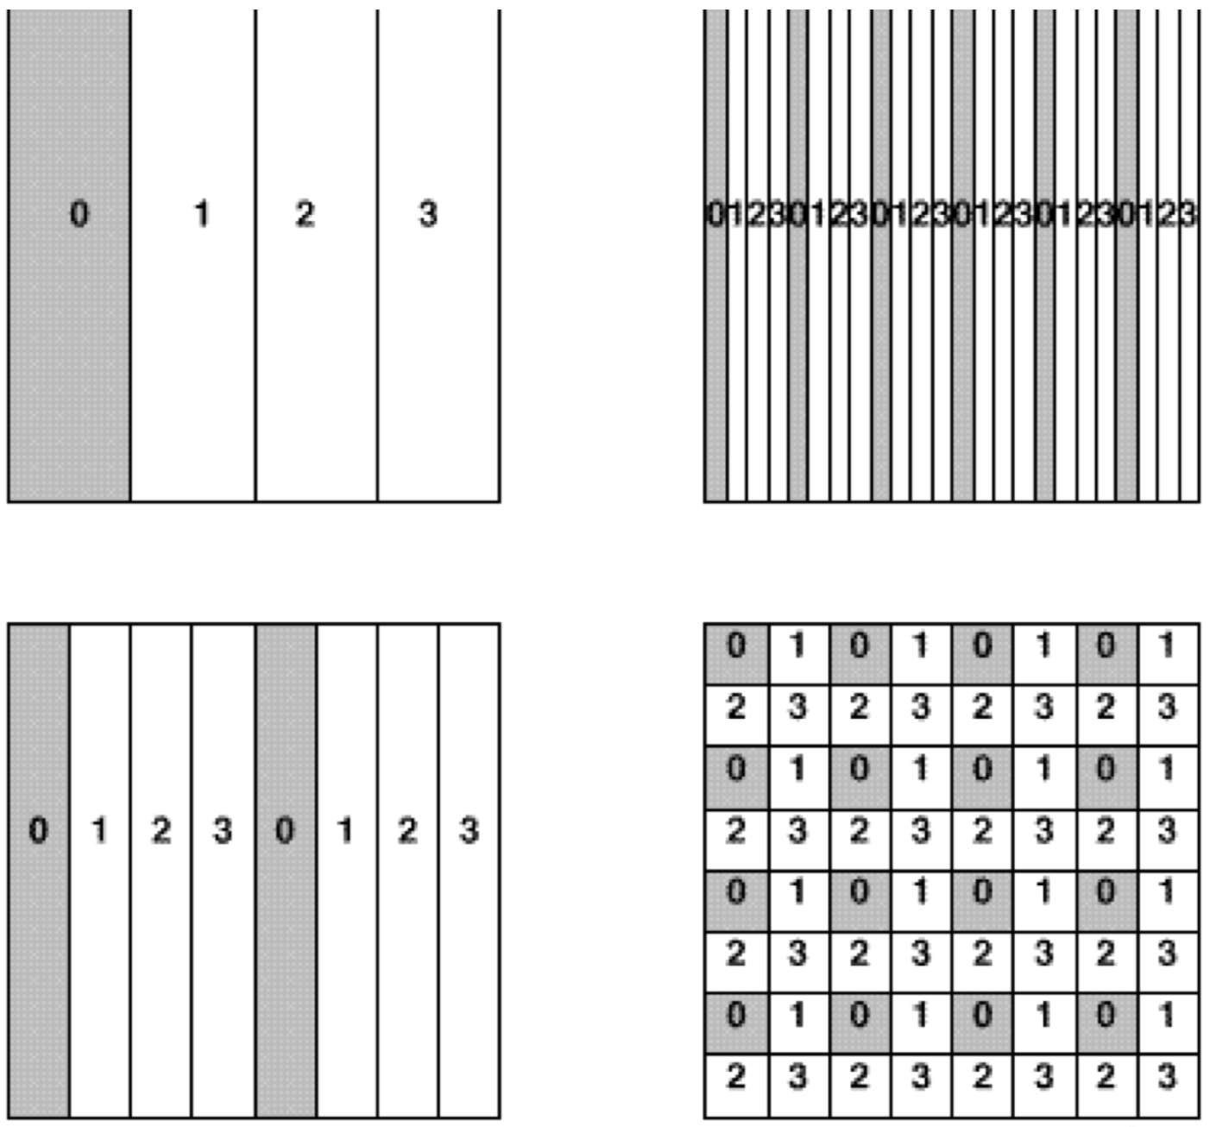
ScaLAPACK: Scalable LAPACK
ScaLAPACK model of computing:
1-dimensional array of processes for operations on band or tridiagonal matrices
2-dimensional process grid for operations on dense matrices
To use ScaLAPACK, all global matrices or vectors should be distributed on this array or grid prior to calling the ScaLAPACK routines
1-d Array
2-d Array

Slide 35
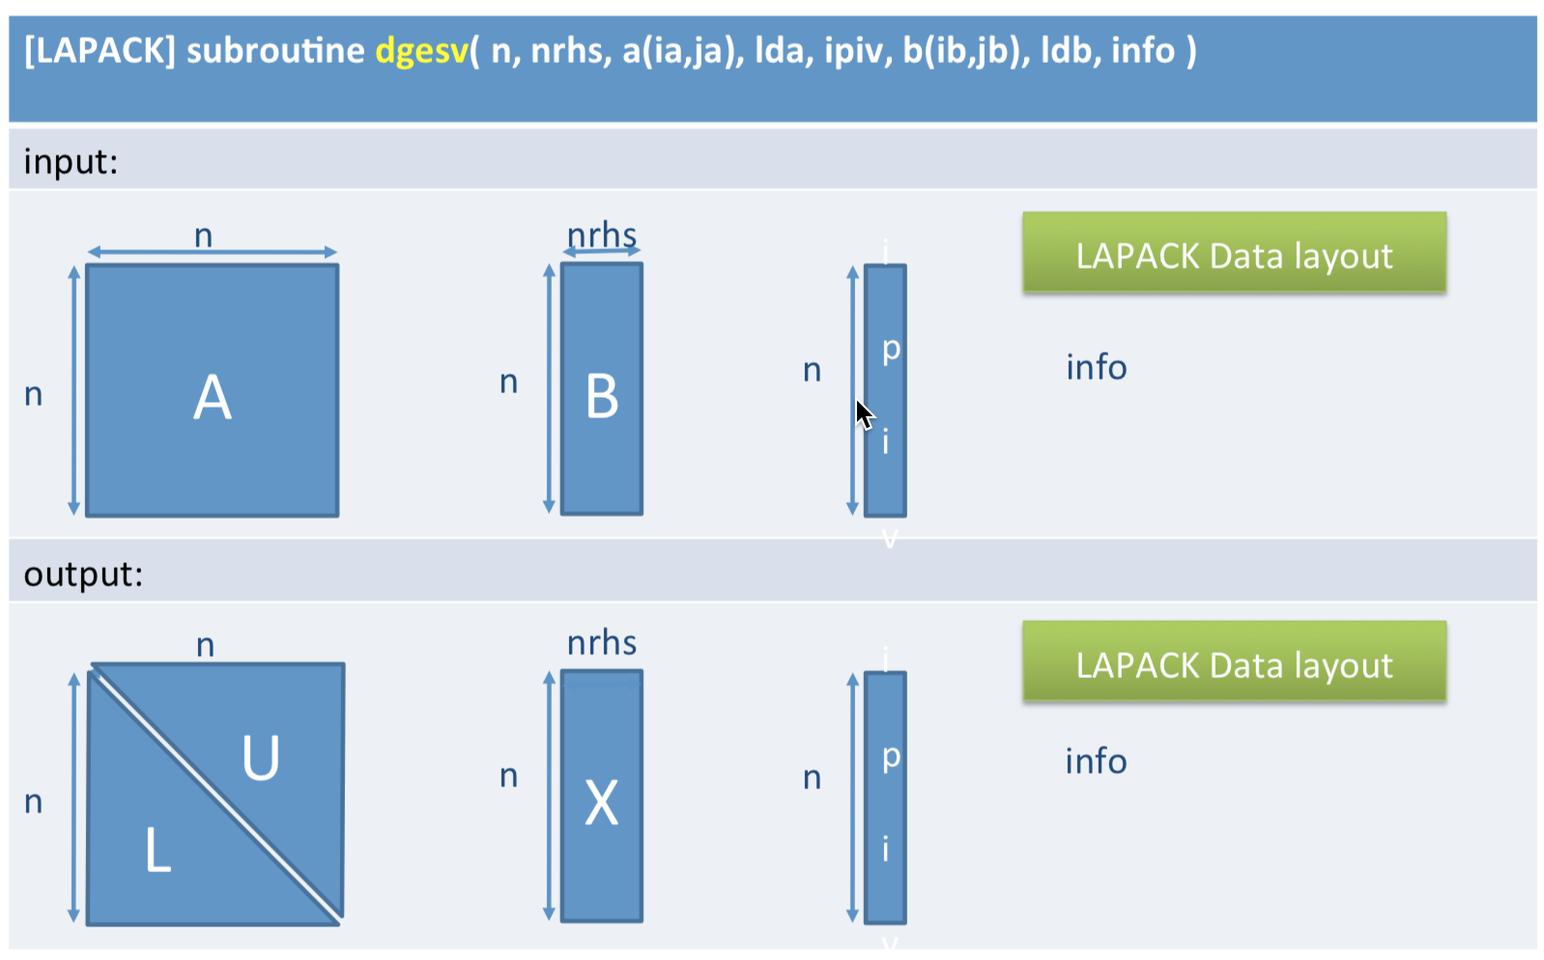
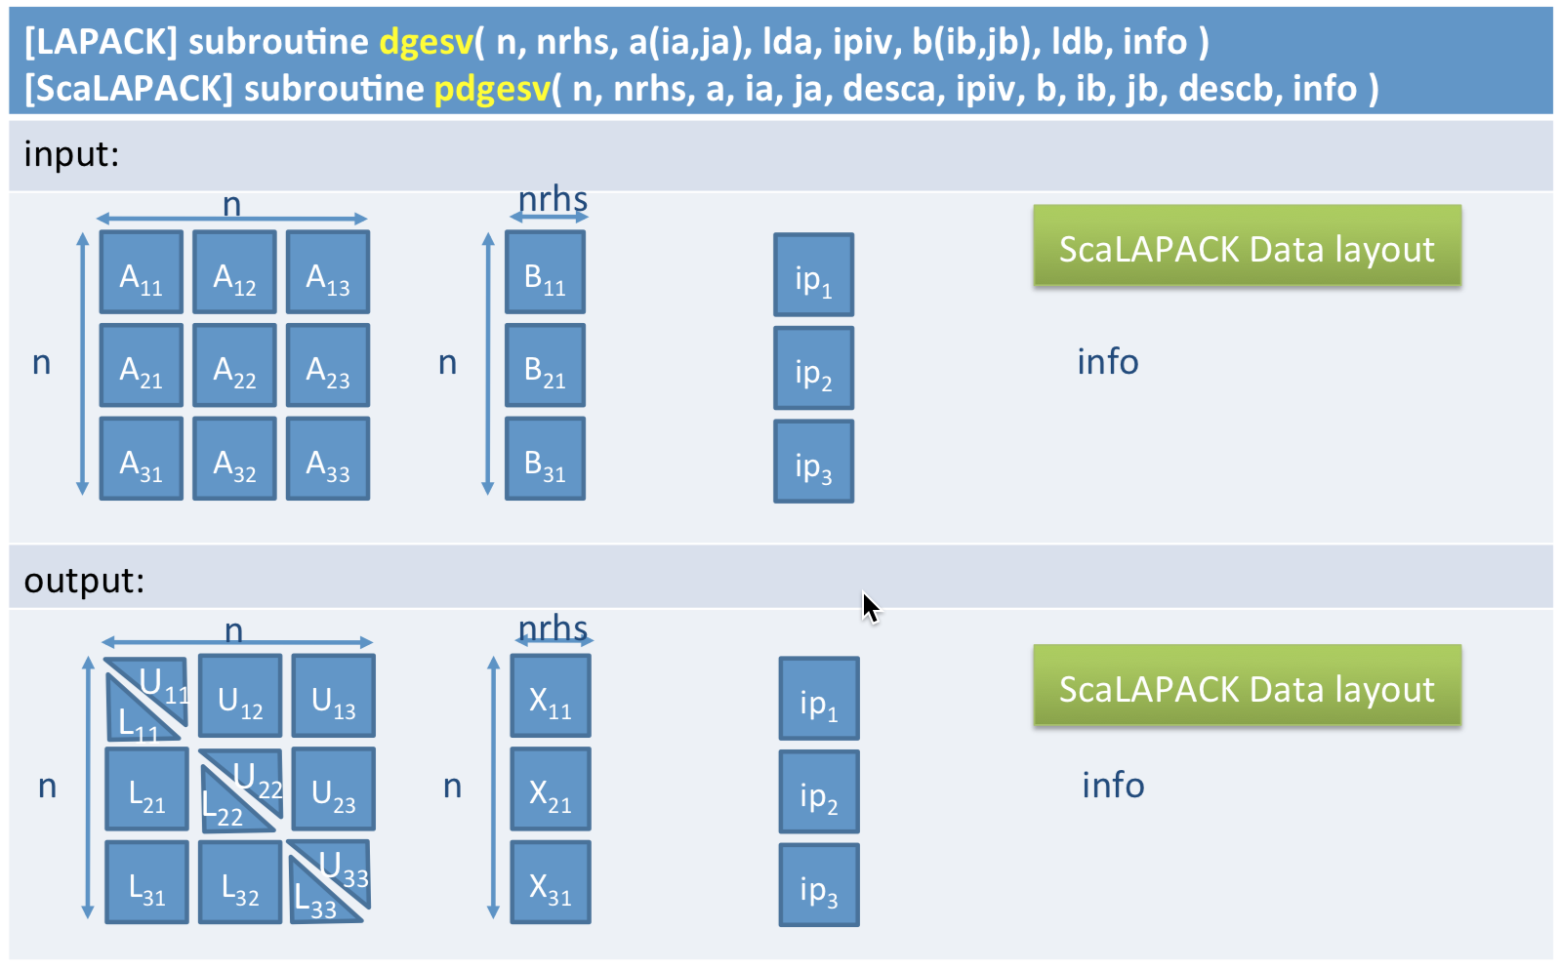
From LAPACK to ScaLAPACK

Slide 36
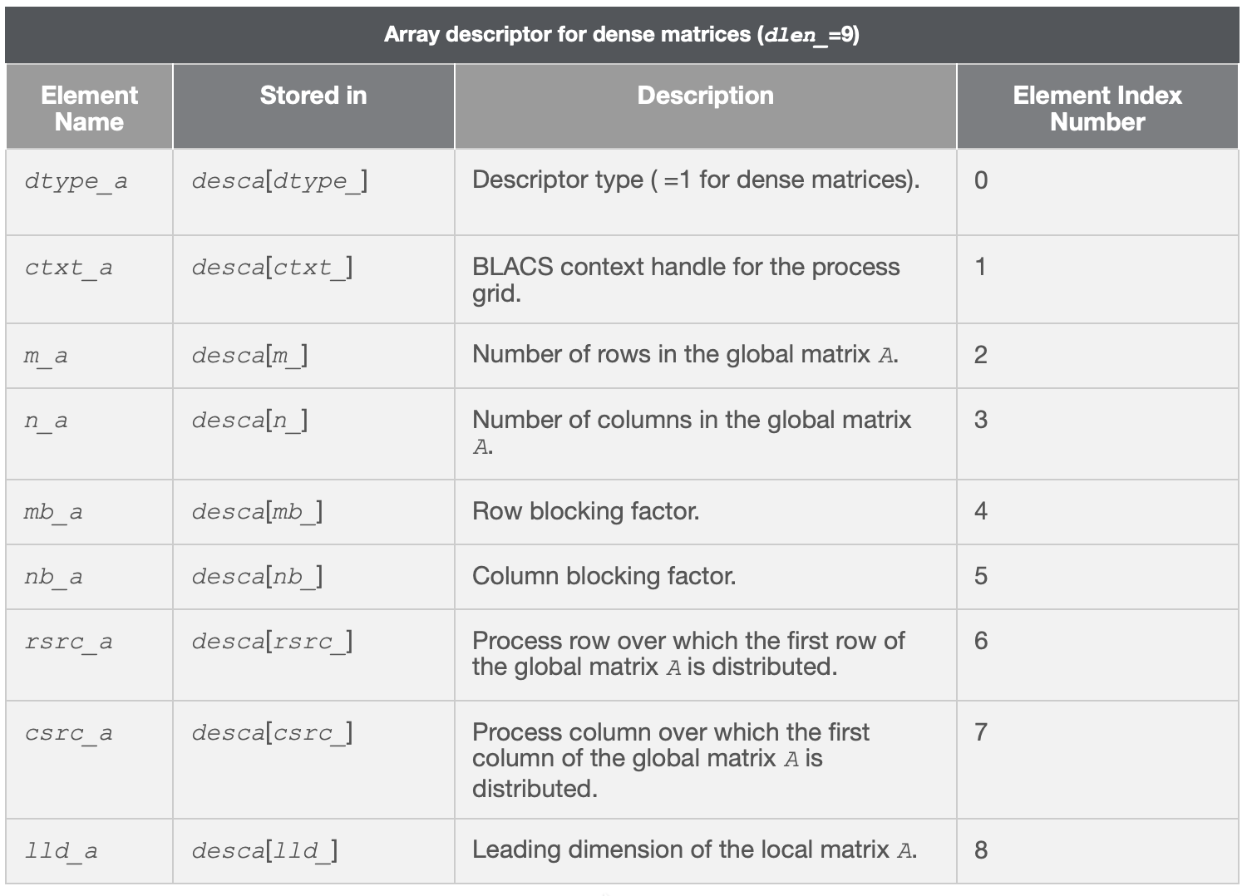
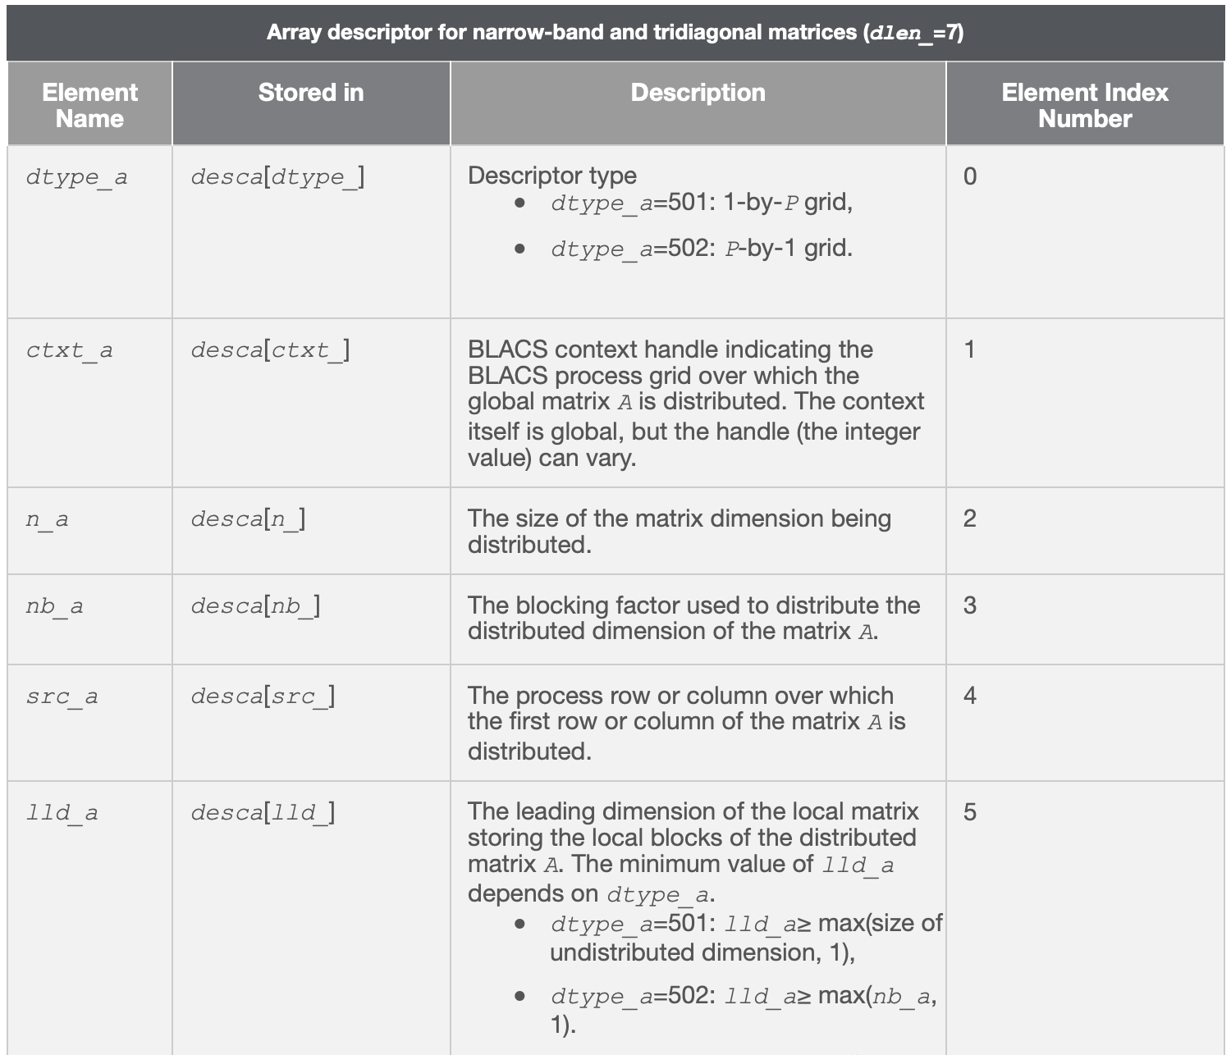
ScaLAPACK: Array Descriptors
Let A be a two-dimensional block cyclicly distributed matrix with array descriptor desca
The meaning of each array descriptor element depends on the type of the matrix A

Slide 37
ScaLAPACK: Computational Routines
Main computational routines perform distinct computational tasks that can be used for:
Solving Systems of Linear Equations
Orthogonal Factorizations and LLS Problems
Symmetric Eigenproblems
Nonsymmetric Eigenproblems
Singular Value Decomposition
Generalized Symmetric-Definite Eigenproblems
Besides this ScaLAPACK has a battery of auxiliary routines to help pose and transform problems and matrices
See MKL ScaLAPACK documentation for details

Slide 38
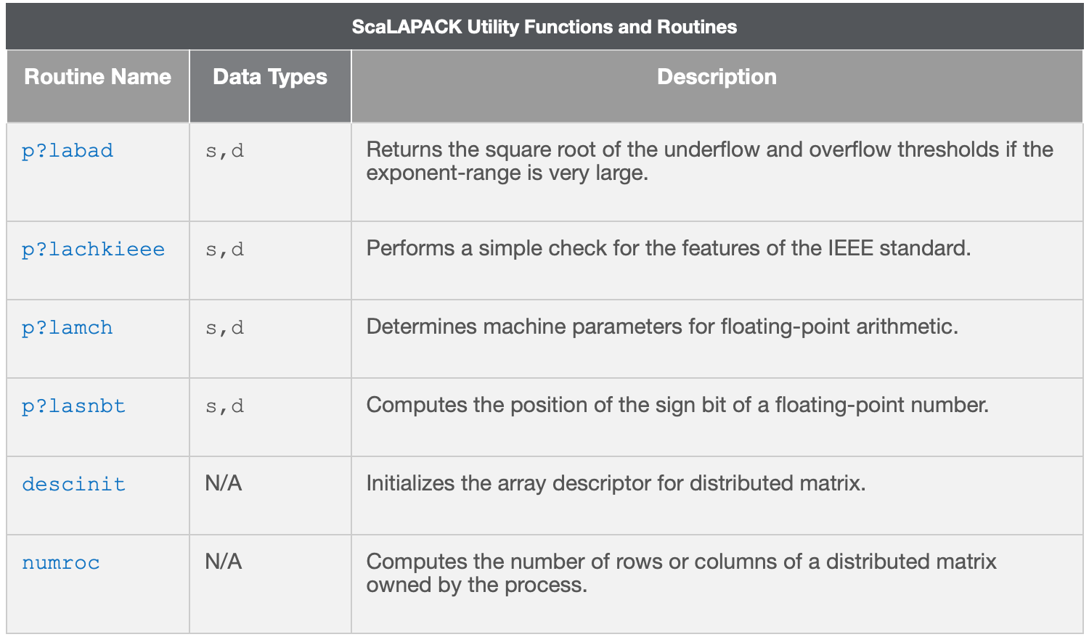
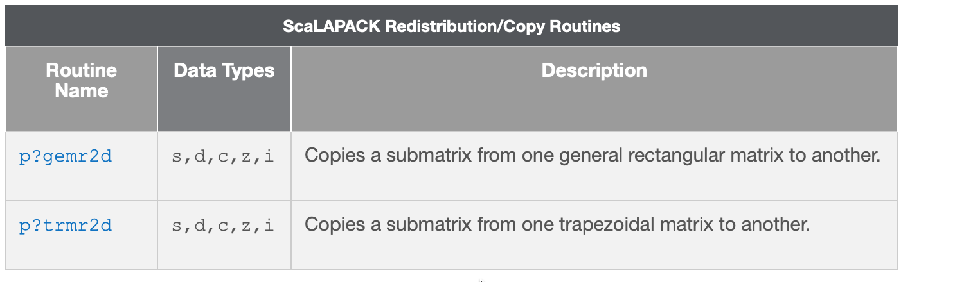
ScaLAPACK: Other Routines
Other routines: Utility Functions and Redistribution/Copy

Slide 39
ScaLAPACK Naming Conventions I
Each subroutine name in ScaLAPACK, which has an LAPACK equivalent, is simply the LAPACK name prepended by a P
All driver and computational routines have names of the form P?YYZZZ, where for some routines the seventh character is blank
Symbol ? indicates the data type:
The next two letters YY indicate the type of matrix
The last three letters ZZZ indicate the computation performed (see next slide)

Slide 40
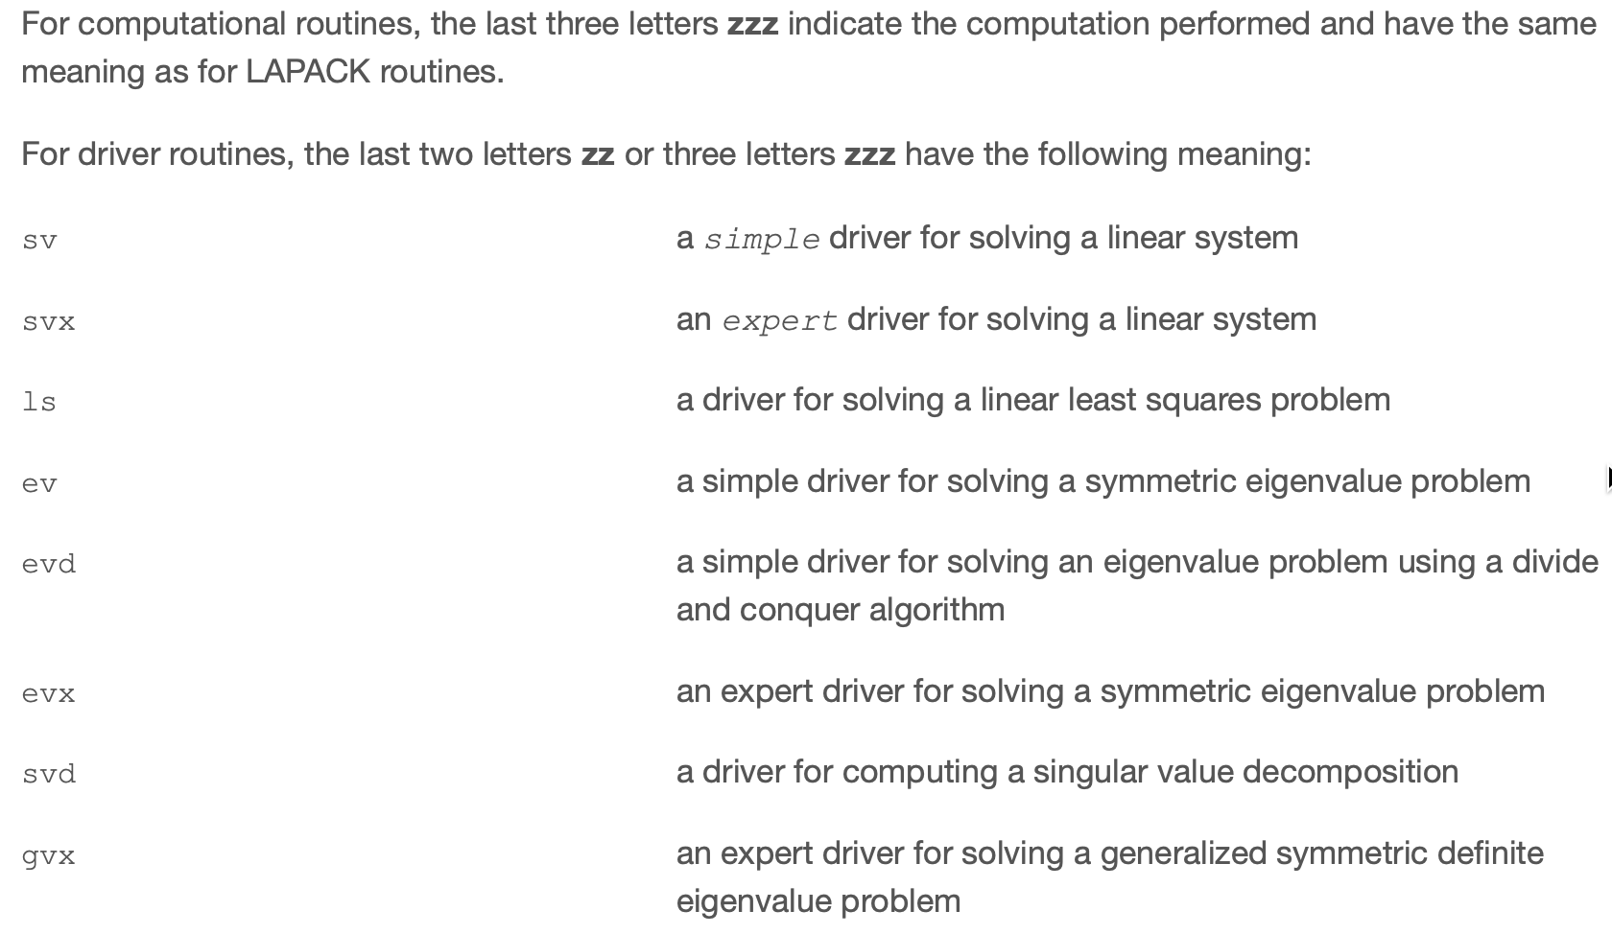
ScaLAPACK Naming Conventions II

Slide 41
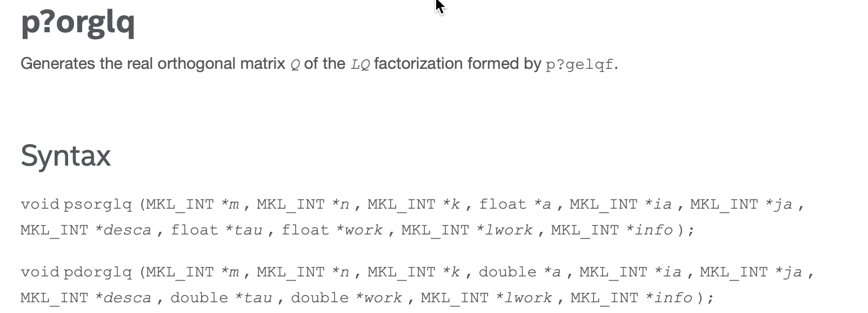
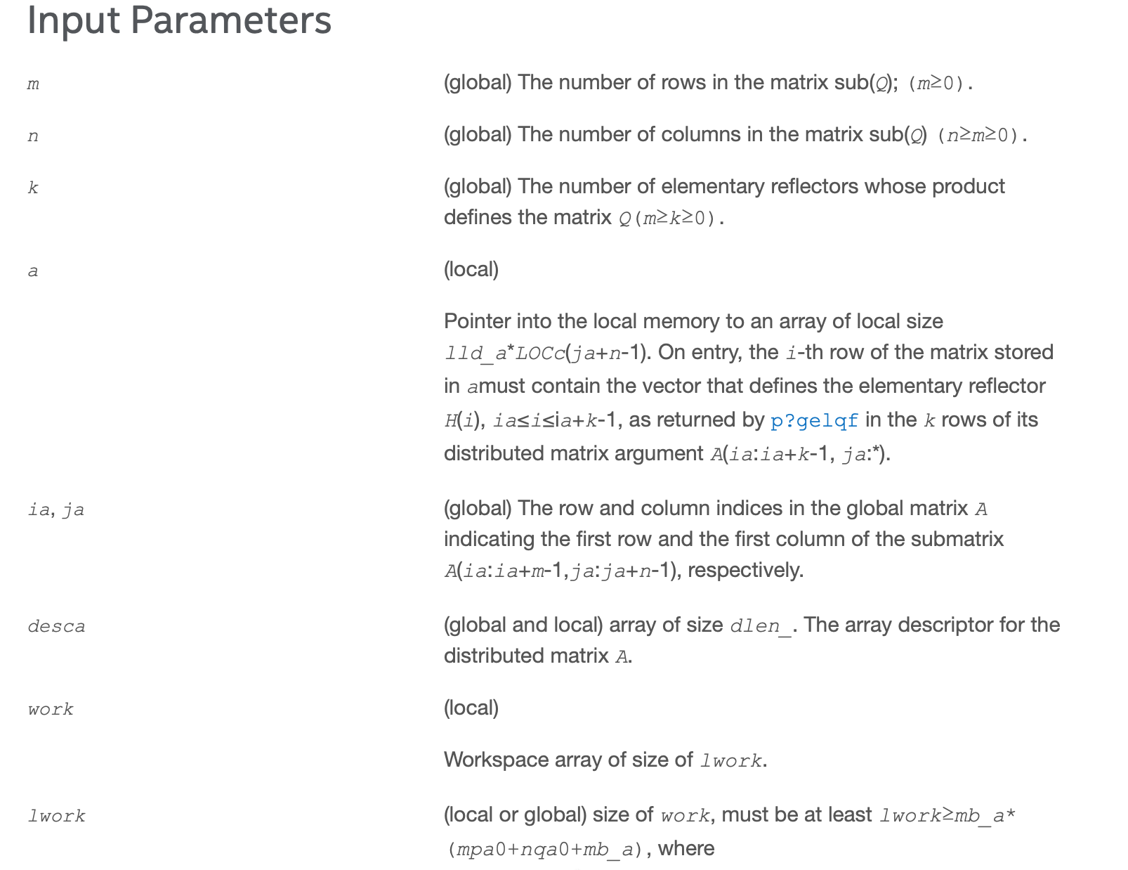
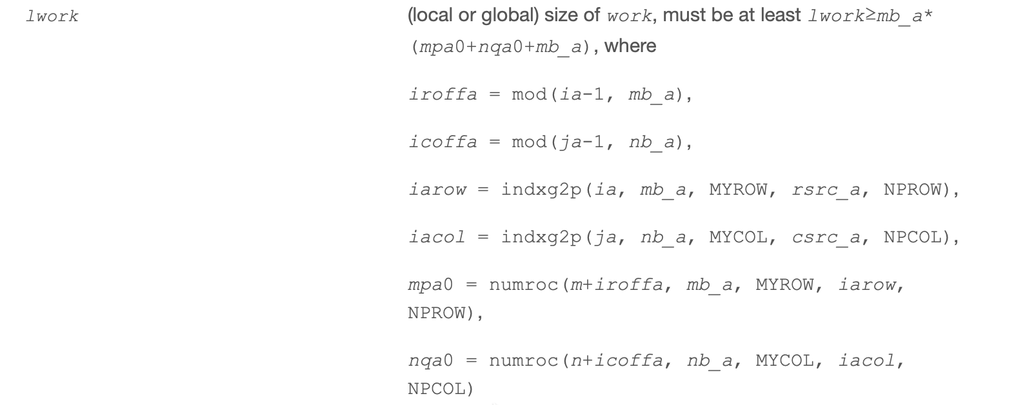
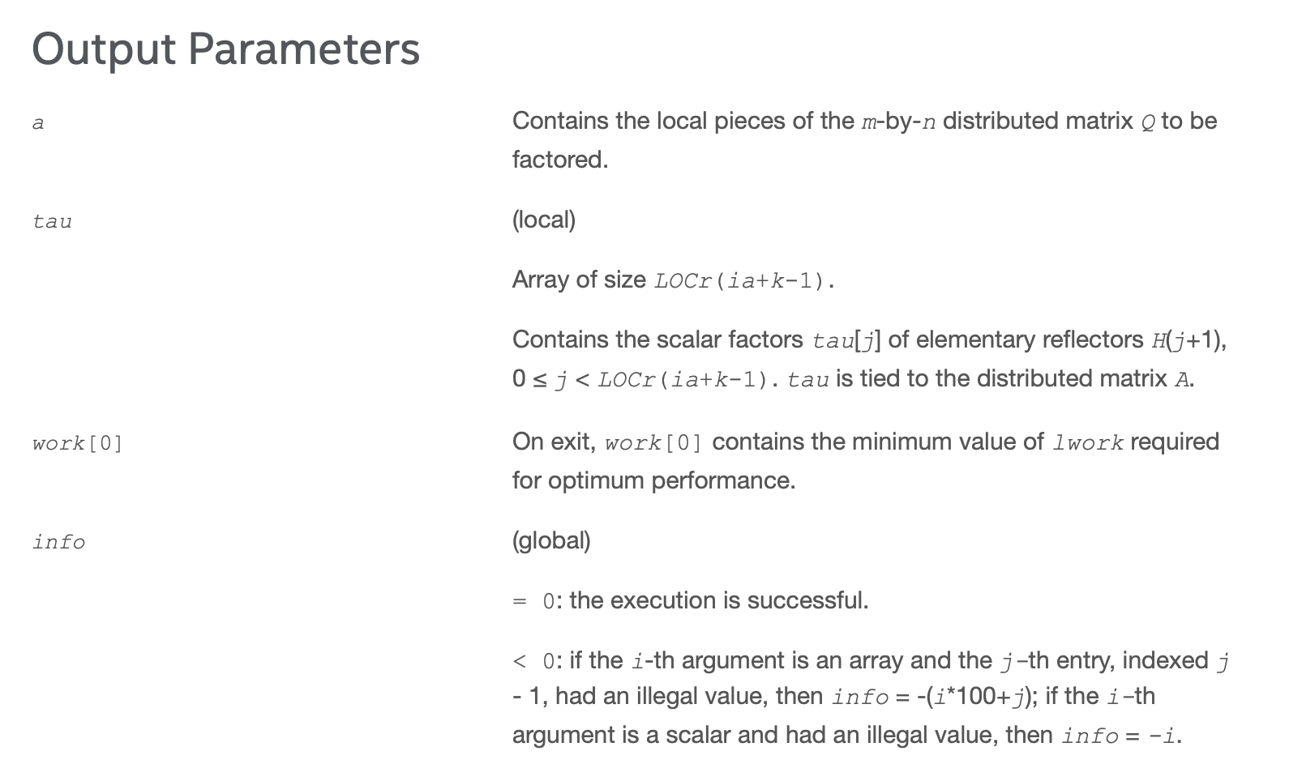
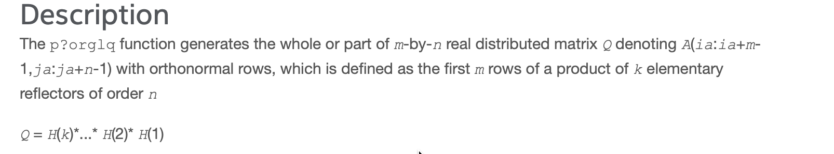
ScaLAPACK Naming Conventions III: Concrete Example

Slide 42
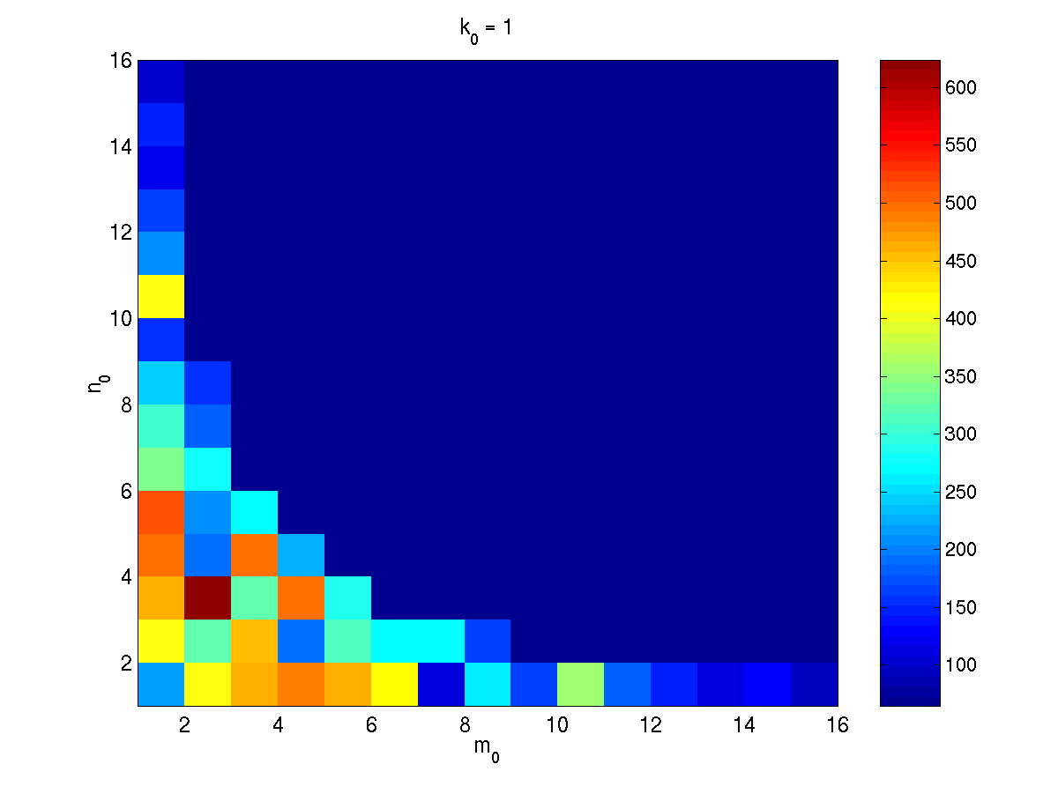
ScaLAPACK Performance I
ScaLAPACK performance depends on system configuration and matrix subdivisions
Optimizing performance requires automation (looking for a needle in a haystack)
Here!

Slide 43
ScaLAPACK Performance II
ScaLAPACK performance depends on system configuration and matrix subdivisions
Times obtained on:
60 processors, Dual AMD Opteron 1.4GHz Cluster w/Myrinet Interconnect
2GB Memory

Slide 44
Example: ScaLAPACK
LaPACK_Example.c

Slide 45
Statistical Functions*
Statistical functions in MKL are known as Vector Statistics (VS)
These are statistical functions designed for the purpose of:
Generating vectors of pseudorandom, quasi-random, and non-deterministic random numbers
Performing mathematical operations of convolution and correlation
Computing basic statistical estimates for single and double precision multi-dimensional datasets
In the following slides we will explore these three areas in some detail…

Slide 46
Random Number Generator Performance Data
Clocks Per Element (CPE):
Unit of measure used when calculating the number of random numbers generated by RNGs,
It is independent from processor clock rate
For example, if the generator performance is equal to 10 CPE and the processor rate is 1 GHz, the generator will produce 108 random numbers per second
VS BRNGs differ from each other in speed
Performance of a distribution generator depends on the method chosen for transforming a uniform distribution to a given non-uniform one

Slide 47
Random Number Generators I
Commonly used pseudorandom, quasi-random, or non-deterministic random number generators with continuous and discrete distributions
High performance achieved via calls to the highly optimized MKL Basic Random Number Generators (BRNGs) and vector mathematical functions
All VS routines can be classified into three major categories:
Registration routines for basic pseudorandom generators and routines that obtain properties of the registered generators
Routines to handle random number streams: create, initialize, delete, copy, save to a binary file, load from a binary file, get the index of a basic generator
Transformation routines for different types of statistical distributions, for example, uniform, normal (Gaussian), binomial, etc.

Slide 48
Random Number Generators II
The model of MKL VS used for random generation follows closely the random generation ideas studied earlier in class
The basic steps to follow are:
Select a Basic Random Number Generator (BRNG) capable of generating uniform distributions
Define a stream of random numbers based on your BRNG
Apply to the random stream a transformation method to obtain random numbers with the desired distribution
Each distribution has its own set of possible transformation methods to use. For example:
Gaussian distribution has Box-Muller, Box-Muller 2, and Inverse CDF transformation methods available
Poisson distribution has the acceptance rejection and Inverse CDF methods available

Slide 49
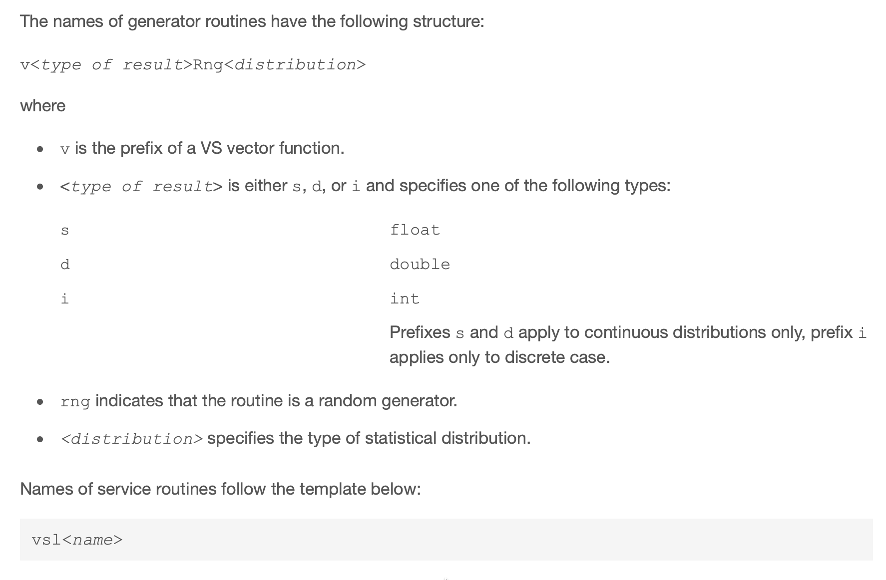

RNG: Generator Names
Examples:
vdRngGaussian
vsRngGaussian
viRngPoisson

Slide 50

RNG: Generator Prototype
Example:
vdRngGaussian(VSL_RNG_METHOD_GAUSSIAN_ICDF, stream, 1000, r, 5.0, 2.0)

Slide 51


RNG: Method Names
Examples:
VSL_RNG_METHOD_GAUSSIAN_ICDF
VSL_RNG_METHOD_GAUSSIAN_BOXMULLER_ACCURATE
VSL_RNG_METHOD_POISSON_PTPE (Acceptance-Rejection)

Slide 52

RNG: Code Example

Slide 53
RNG: Streams
Stream:
Abstract source of random sequences of uniform distribution
State Descriptors:
Holds state descriptive information for a particular BRNG
Is a necessary parameter in each routine of a distribution generator
Only the distribution generator routines operate with random streams directly
Stream Creation and Deletion:
We can create unlimited number of streams by VS Service Routines like NewStream and utilize them in any distribution generator to get the sequence of numbers of given probability distribution
When the stream are no longer needed should be deleted calling DeleteStream
Service Functions:
We are provided with many service functions such as SaveStreamF and LoadStreamF to save random stream descriptive data to a binary file and to read this data from a binary file respectively
Pointer to stream state. Used to capture, set , and read the state of the RNG stream.
Initializing a new RNG stream:
Address of stream state
Method used to generate the random numbers
Seed
Using RNG stream in a distribution generation
Deletion of RNG stream

Slide 54
RNG: Streams Naming
Stream:
Abstract source of random sequences of uniform distribution

